Slide 1
Wage Determination Lesson 2
A2 Economics

Slide 2
Aims and Objectives
Aim:
To understand wage determination
Objectives:
Explain economic rent and transfer earnings/
Be able to draw economic rent and transfer earnings diagrams.
Analyse the football labour market.

Slide 3
Starter
Define economic rent
Define transfer earnings

Slide 4
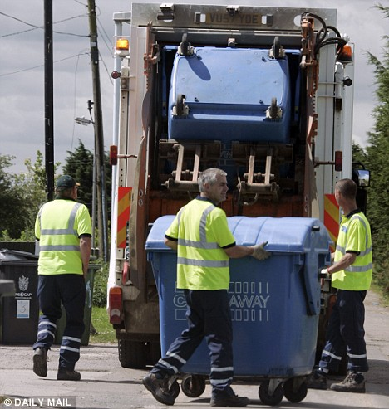
Case Study: Premiership Footballers
Premiership footballers earn large economic rents.
Imagine what the next best job for Rio Ferdinand would be….
Rent= £109,750 pw
Transfer Earnings £250 pw
£110,000 pw

Slide 5
Economic Rent and Transfer Earnings
Total Earnings = OWQA
Real Wage Rate/MRP
S
Economic Rent = WAB
A
W
Transfer Earnings = OABQ
B
D=MRP
O
Q
Quantity of Labour

Slide 6
Inelastic Labour Supply Leads to High Levels of Economic Rent
SI
Real Wage Rate/MRP
SE
SI
Economic Rent = A+B
Transfer Earnings = C
W
SE
Economic Rent = A
Transfer Earnings = B+C
A
D=MRP
B
C
O
Q
Quantity of Labour

Slide 7
Rent and Transfer Earnings Under Extreme Elasticity Conditions
S
Real Wage Rate
Real Wage Rate
W1
S
W1
Economic Rent
Transfer Earnings
D1=MRP
D1=MRP
Q
Quantity of Labour
Q
Quantity of Labour
Perfectly Inelastic Supply
Perfectly Elastic Supply

Slide 8
Economic Rent and Transfer Earnings
The amount of economic rent earned by individual workers will differ.
First worker would have been prepared to work for much less than the wage rate actually paid, so a high proportion of his earnings will be economic rent.
The last worker to be employed would have been prepared to work only for the given wage rate and so earns no economic rent.

Slide 9
Case Study: Premiership Footballers
The proportion of earnings made up of economic rent depends on the elasticity of supply.
Economic rent will be a large proportion of earnings when supply is inelastic.

Slide 10
Case Study: Premiership Footballers
Supply will be inelastic as if the changed the wage rate most footballers would continue to supply themselves.
Real Wage Rate/MRP
S
W1
D=MRP
O
Q1
Quantity of Premiership Footballers

Slide 11
Panorama UK Labour Market
Video

Slide 12
Trade Unions
An organisation of workers who join together to further their own interests.

Slide 13
Trade Unions
http://www.youtube.com/watch?v=0vUDrUYTsHQ&feature=results_video&playnext=1&list=PL4CEC04390392C406
http://www.youtube.com/watch?v=nDvGxNkX4AU
http://www.youtube.com/watch?v=wbT5q1Jrfhs&feature=related
3.29
2.00

Slide 14
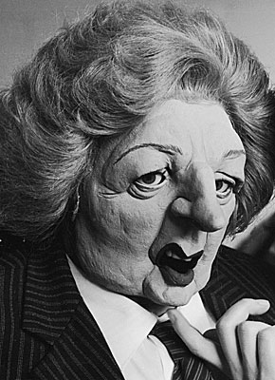
Trade Unions
Discuss how Trade Unions may influence wage rates and the labour supply?
Do you feel as though the power of trade unions was lessened by Margaret Thatcher?

Slide 15
Trade Unions
Furthers the interests of its members through a process of collective bargaining with employers.
Union acts as a monopoly seller of labour to bid up the wage rate of its members.

