Slide 1
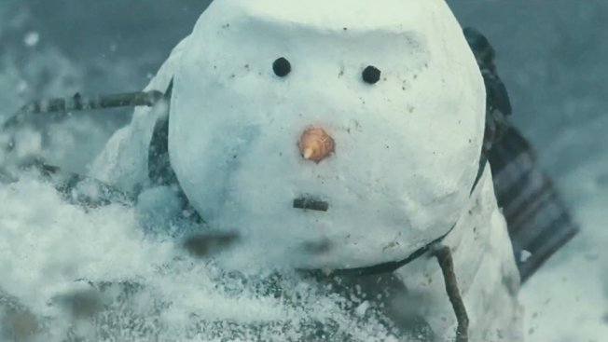
Understanding Markets
AS Business Studies

Slide 2
Aims and Objectives
Aim:
Understand market share, size and growth
Objectives:
Define market share, size and growth
Calculate market share and growth
Analyse changing market share and growth
Evaluate changing market shares

Slide 3
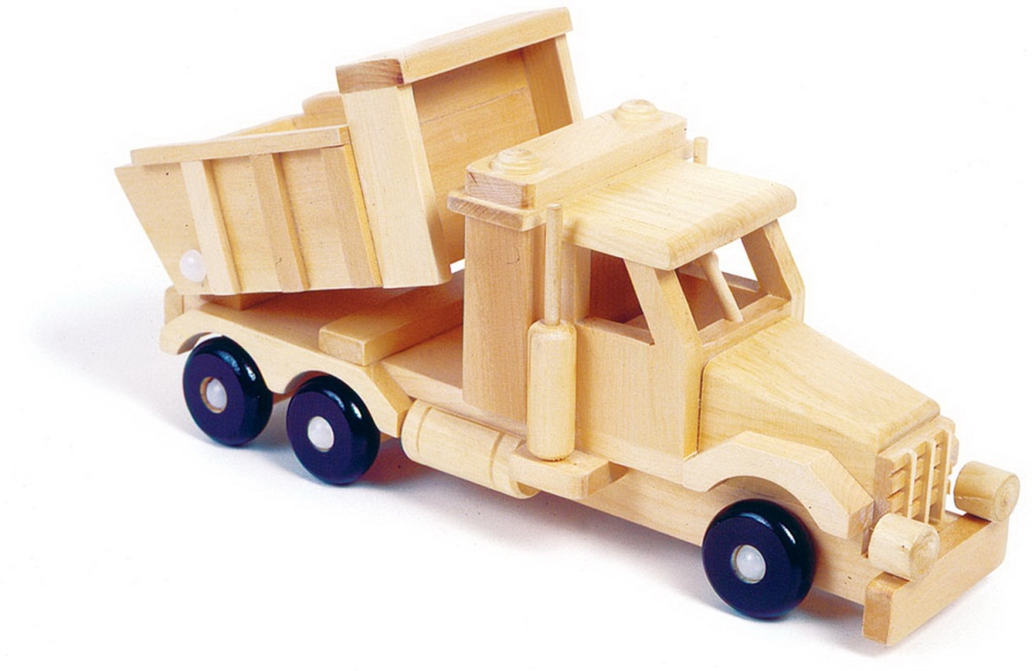
Starter
Give three factors which would determine the demand for wooden toys.

Slide 4
Starter
Give three factors which would determine the demand for water jet packs.
Price to buy the Jet Pack is £60,000. Water Sports/Extreme Sports businesses in the USA, are charging eqv of £150 to hire for 1 hour!

Slide 5
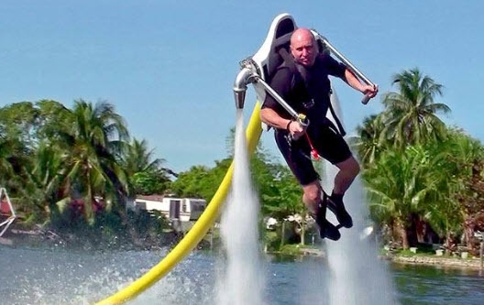
Starter
Attractiveness of Price
Quality of Product (Safety)
Tastes & fashions
Competitor actions

Slide 6
Demand
How might the following affect demand for John Lewis’ products?
http://www.youtube.com/watch?v=0N8axp9nHNU
1 million hits a week on YouTube alone!
What other factors will affect demand for John Lewis’s products?

Slide 7
Online Presence
Business without a physical presence, but has an online one. E.g. Facebook

Slide 8
Online Presence
http://www.bbc.co.uk/programmes/p00m5cxv
Facebook 1 in 7 of worlds’ population uses Facebook?
How does Facebook generate revenues and profits?
What determines demand for Facebook?

Slide 9
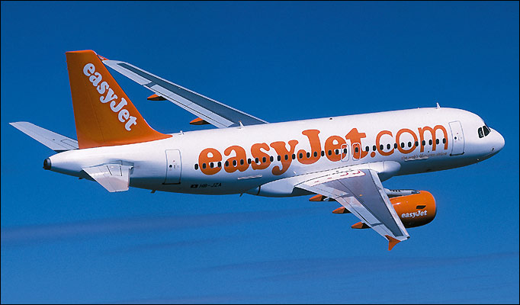
Online Presence
Budget airlines generate revenues by selling direct to consumers with a high proportion of bookings made online.

Slide 10
Technological Change Provides an Opportunity to Change Business Models
The Product Being Sold
The materials/production processes
How the product is sold
What distribution channel is used
Customisation
Pricing model
Target market

Slide 11
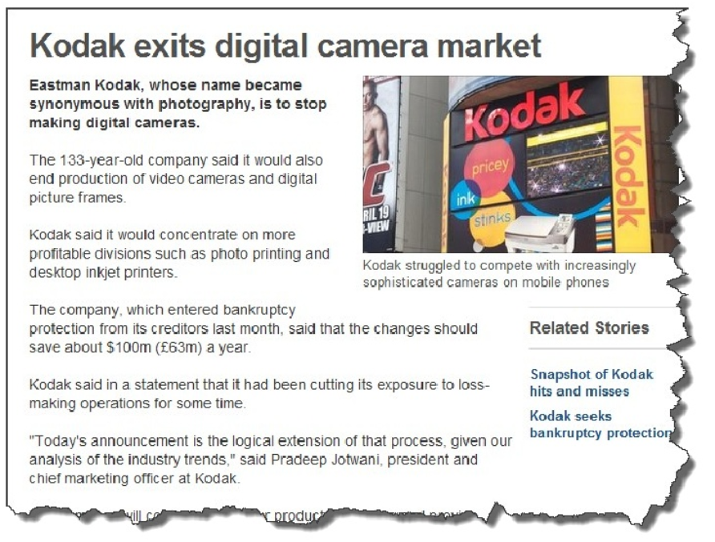
Technology as a Threat

Slide 12
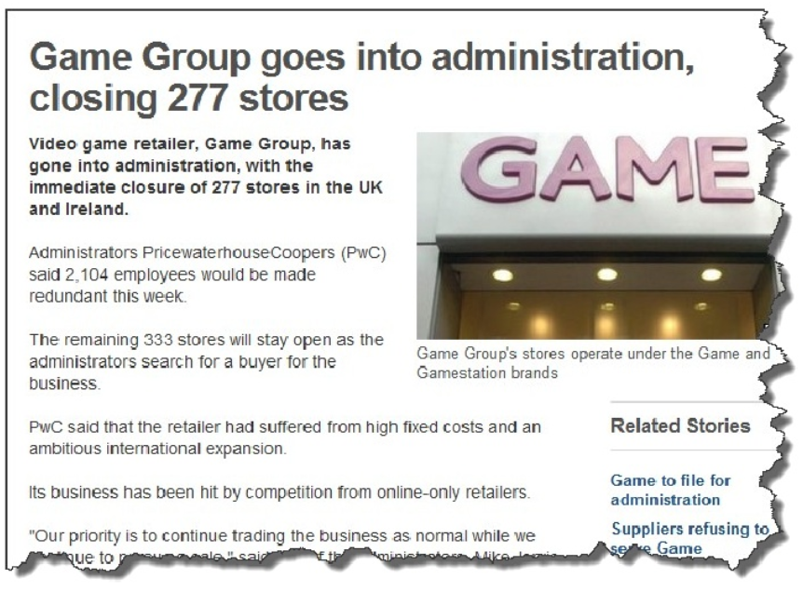
Technology as a Threat

Slide 13
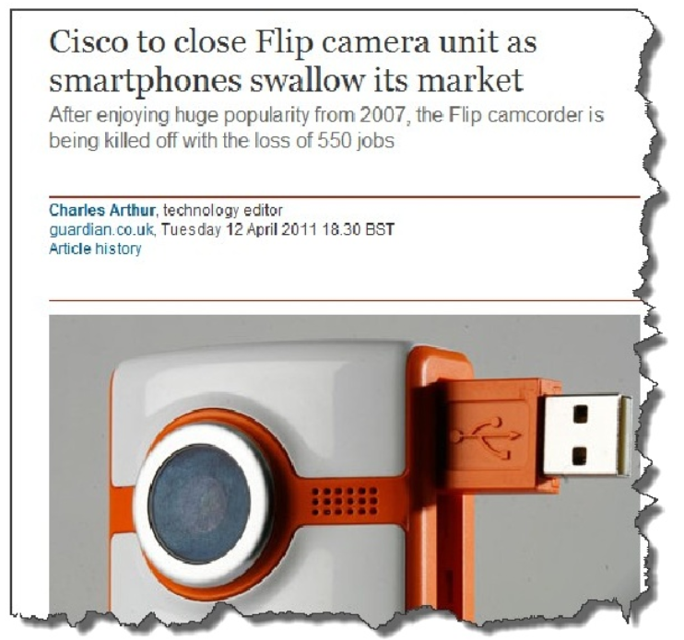
Technology as a Threat

Slide 14
AN: Virtual Presence
Benefits
Disadvantages
World market access
Low cost
24/7 opening times
Start-up and running costs are low
Opens revenue channels
Nearly all customers have access to markets
Price transparency – all customers have access to all prices
Click fraud!
Feedback can be left which is damaging if negative
Loss of customer service

Slide 15
Calculate Market Share
Total Sales Of Firm
---------------------------- X 100
Total Sales of Industry

Slide 16
Market Growth
How much value of market has changed
------------------------------
The original value of the market
X 100

Slide 17
Market Size
The measurement of the size of total sales for a whole market expressed in terms of value of sales or volume of sales (units).

Slide 18
EV: Virtual Presence
What does the success of having a virtual presence depend on?

Slide 19
Market Size, Growth and Share
Case Studies

