Slide 1
Understanding Markets
AS Business Studies

Slide 2
Aims and Objectives
Aim:
Understand market segments and market mapping.
Objectives:
Define market segmentation
Explain why markets are segmented
Analyse market mapping
Evaluate market mapping

Slide 3
Starter
Define quantitative data
Define qualitative data
Give two examples of each
Which method is better and should be used by businesses?

Slide 4
Marketing Challenge
Identify groups of customers who have similar needs and wants.
Find a way of offering (positioning) a product which is attractive to those customer groups.

Slide 5
Market Segmentation

Slide 6
Market Segments
Market Segments
Part of a market that contains a group of buyers with similar buying habits.
The way a business segments its market depends on the product being sold and the customer.

Slide 7
Market Segments
Age
Gender
Geographical Area
Ethnicity
Religious Groups
Socio Economic Group
Activity:
Stand in your market segment.

Slide 8
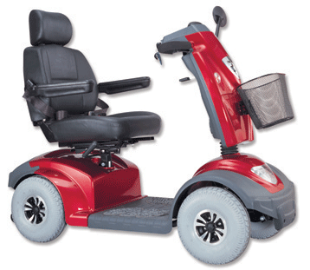
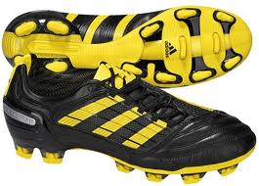
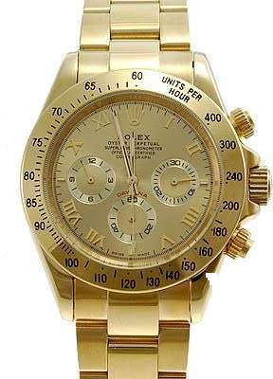
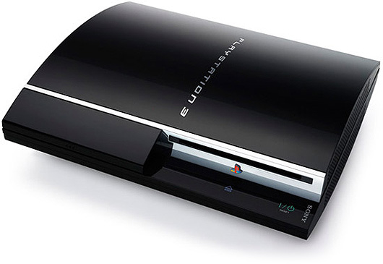
Market Segments

Slide 9
Market Segments
Why would a business want to split their market into segments?
A business would want to split their market into segments, so that they can target their specific customers more easily to make sales and profit.

Slide 10
Price Sensitivity
Price Sensitivity:
When the price is very important in the decision about whether or not to buy a product/service.

Slide 11
Price Sensitivity
Product | Original Price | New Price | I Would Still Buy. | I Would Not Buy Anymore.
Big Mac | £2.49 | £3.49
T Shirt | £14.99 | £18.99
Bottle of Water | £0.99 | £2.99
Jeans | £34.99 | £72.99
iPad | £399.99 | £549.99
Bag | £29.99 | £25.99
Innocent Smoothie | £2.49 | £4.20
Football Boots | £34.99 | £39.99
Computer Game | £49.99 | £58.99

Slide 12
Examples of Segments - Holidays

Slide 13
EV: Limits of Market Segmentation
Lack of information and data: some markets are poorly researched with little info on what customers want.
Difficulty in measuring and predicting consumer behaviour: humans don’t all behave in the same way all of the time.
Hard to reach customer segments once identified: can be difficult to target customer with effective marketing message.

Slide 14
Market Mapping
The market map illustrates the range of ‘positions’ that a product can take in a market based on two dimensions that are important to customers.

Slide 15
Possible Dimensions
Low Price | High Price
Basic Quality | High Quality
Low Volume | High Volume
Necessity | Luxury
Light | Heavy
Simple | Complex
Low-tech | Healthy
Unhealthy | Hi-tech

Slide 16
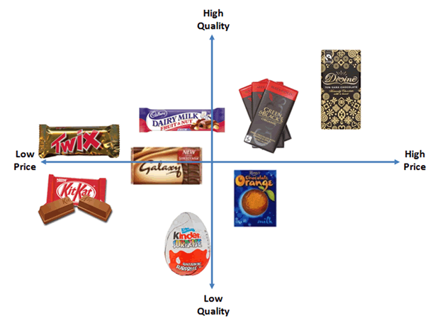
Market Map of Chocolate
Gap in the Market:
Occurs when no business is currently serving the needs of customers for a particular product.
Gap in the Market

Slide 17
Your Own Market Map
Create Your Own Market Map for one of the following markets or one of your choice:
Chocolate Bars
Fashion
Sportswear
Make-Up
Cars
Computers
Mobile Phones
Restaurants
High Quality
Low Price
High Price
Extension Task: Identify where there are any gaps in your market.
Low Quality

Slide 18
Market Mapping Analysis
Advantages
Disadvantages
Helps spot gaps in the market.
Useful for analysing competitors.
Encourages use of market research.
Just because there is a gap in the market doesn’t mean there is demand.
Not a guarantee of success.

Slide 19
EV: Limits of Market Mapping
What does the success of market mapping depend on?
The quality of the research and data.
The opinions of entrepreneur, due to subjective nature.
The skills of the entrepreneur in exploiting the gap in the market.

