Slide 1
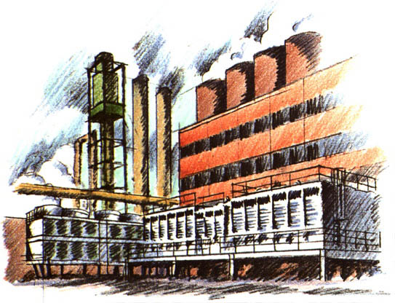
Theory of Production
A2 Economics

Slide 2
Aims and Objectives
Aim:
Understand the short run theory of production.
Objectives:
Define fixed, variable and total costs.
Explain the difference between SR and LR.
Analyse the effects of increasing production in the short run.

Slide 3
Starter
Define:
Fixed Costs
Variable Costs
Total Costs

Slide 4
Costs
Fixed Costs:
Costs of production that do not change as output varies.
Variable Costs:
Costs of production that vary with output.
Total Costs:
Fixed costs + Variable costs

Slide 5
Short Run & Long Run
SR:
Period during which FC and scale of output remain fixed.
LR:
Period of time during which all factors become variable and the scale of output varies.

Slide 6
Marginal Product
When a factory wants to increase output.
It must hire more labour to do so.
MP:
The value of the output added by the extra worker.

Slide 7
Theory of Production Worksheet
Scenario:
A vintage car manufacturing business wishes to increase its output in the short run. We assume that at least one factor of production remains constant, for example the size of the factory. To increase their output the firm has decided to hire extra workers.
Complete the table using the following formulas:
Average Product = Total Product / No of Workers
Marginal Product = Difference between the total product values for each additional worker.

Slide 8
No. of Workers | Total Product | Average Product | Marginal Product
1 | 3
2 | 7
3 | 16
4 | 28
5 | 45
6 | 60
7 | 63
Now you have calculated the table above, plot on a graph the figures from the No. of Workers Column (X Axis) and the Marginal Product (Y Axis)

Slide 9
No. of Workers | Total Product | Average Product | Marginal Product
1 | 3 | 3 | 3
2 | 7 | 3.5 | 4
3 | 16 | 5.3 | 9
4 | 28 | 7 | 12
5 | 45 | 9 | 17
6 | 60 | 10 | 15
7 | 63 | 9 | 3
Now you have calculated the table above, plot on a graph the figures from the No. of Workers Column (X Axis) and the Marginal Product (Y Axis)

Slide 10
Comment on anything of significance that you notice.
At what No. of Workers do you think it is optimal for the firm to stop employing additional workers?

Slide 11
Increasing Marginal Returns
No. of Workers | Total Product | Average Product | Marginal Product
1 | 3 | 3 | 3
2 | 7 | 3.5 | 4
3 | 16 | 5.3 | 9
4 | 28 | 7 | 12
5 | 45 | 9 | 17
6 | 60 | 10 | 15
7 | 63 | 9 | 3
Increasing Marginal Returns
Where the addition of an extra variable factor adds more to output than the previous factor.

Slide 12
Increasing Marginal Returns

Slide 13
Law of Diminishing Marginal Returns
No. of Workers | Total Product | Average Product | Marginal Product
1 | 3 | 3 | 3
2 | 7 | 3.5 | 4
3 | 16 | 5.3 | 9
4 | 28 | 7 | 12
5 | 45 | 9 | 17
6 | 60 | 10 | 15
7 | 63 | 9 | 3
Diminishing Marginal Returns
Where increasing amounts of a variable factor are added to a fixed factor and the amount added to total product by each additional unit of the variable factor eventually decreases.

Slide 14
Diminishing Marginal Returns

Slide 15
Diminishing Marginal Returns
Why as you hire more workers might they become less productive?

Slide 16
Diminishing Marginal Returns
Why as you hire more workers might they become less productive?
Law economists use to explain SR production.

