Slide 1
The Relationship Between Businesses and the Economic Environment
A2 Business Studies

Slide 2
Aims and Objectives
Aim:
Understand firm strategy in the business cycle.
Objectives:
Explain the effects of different firm strategies in the business cycle.
Analyse whether economic growth is good or bad for businesses
Define and describe Inflation.

Slide 3
Starter
Draw out the business cycle on your whiteboards
Label each stage of the business cycle
Be prepared to explain what may happen to unemployment, growth and interest rates at each stage of the business cycle.

Slide 4
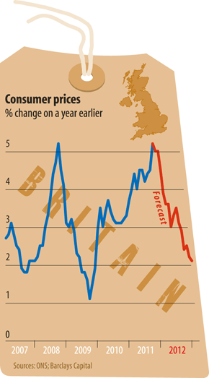
UK Economy
http://www.bbc.co.uk/news/business-16725993
The Economist Article
Behind Every Cloud….Another Cloud

Slide 5
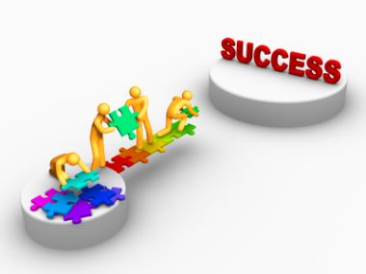
Matching Task
Firstly decide whether the business strategy belongs in a downturn/recession or a recovery/upturn/growth stage of the business cycle.
Match the evaluation points to the business strategy.

Slide 6
Downturn/Recession Strategies | Evaluation
Close facilities as demand falls and excess capacity increases. | Job losses will damage employee relationships and reduce job security for staff remaining.
 | If downturn is short lived then reducing excess capacity could result in a problem of inadequate capacity – how long will downturn last and how serious is it likely to be?
Develop new products that will appeal more to customers as their disposable income falls. | May damage the firm’s reputation and brand image.
 | Not all consumers will see a fall in their disposable income.
Lower prices in an attempt to maintain or grow sales. | Could lead to price wars, reducing profits for all firms in a market.
 | May damage brand image.
 | Demand may be price inelastic and revenue will fall.
Buy up assets cheaply from other businesses – or acquire other businesses for a low price. | This will need to be financed which could be a risky strategy. What if banks aren’t lending?
 | Business could become too big and suffer from integration problems such as diseconomies of scale.

Slide 7
Recovery/ Upturn/ Growth Strategies | Evaluation
Use existing capacity and increase output to meet rising consumer demand | Low risk strategy as no additional capital investment is required.
 | Could mean workers are overloaded and become demoralised.
Expand capacity to meet increases in consumer demand. | Risky Strategy
 | Borrowing may have to increase creating a reliance on liabilities.
 | Can the firm estimate the increase in demand and just how long the period of economic growth will last?
 | If other firms may the same decision, then any increase in competitiveness may just be eroded away!
Research and Develop New Products which will be income elastic | R&D takes a long time and is costly.
 | Business could lose focus on its primary objectives or product portfolio.
 | Could lead to increases in sales and the developing of a competitive advantage.

Slide 8
Economic Growth
Is economic growth always a good thing?
Brainstorm in your groups the potential benefits and drawbacks to a firm of an economy growing.

Slide 9
Consumers have more disposable income, demanding more income elastic goods.
Business investments are likely to have more profitable outcomes.
Higher profits and sales mean more opportunities for expansion strategies.
Business start ups are more likely to succeed.
Increases in government spending fuel growth and mean increases in the standards of education etc. Meaning there is a better quality of worker in the economy.

Slide 10
Rapid economic growth could lead to supply shortages such as labour.
Inflation could be caused as firms try to benefit from increased consumer spending by raising their prices. Inflation may lead to workers demanding higher wages resulting in higher costs for firms.
If inflation rises, and the gov. combats it with raising interest rates, businesses which are highly geared will suffer from increased costs.
Economic growth could encourage businesses to embark on riskier strategies which could be detrimental to the businesses’ success.

Slide 11
Inflation
A2 Business Studies

Slide 12
Inflation
£
Task 1: Break the Code
Task 2: Using the code, answer the four questions.

Slide 13
What is Inflation?
Answers
Task 1, Break the Code:
First think about a planet where you have a basket of goods. Now think that the only basket of goods you can buy are: milk, bread and petrol. They all cost one pound.

Slide 14
What is Inflation?
 | Prices month 1 (£) | Prices month 2 (£)
Milk | £1.00 | £1.05
2) Bread | £1.00 | £1.02
3) Petrol | £1.00 | £1.03
Average Price £ | £1.00 | £1.033
Percentage Change % |  | 3.33%

Slide 15
Inflation Definition:
£
Persistent tendency for prices to rise, resulting in a fall in the real value of money.
http://www.bbc.co.uk/news/business-14115829

Slide 16
How is Inflation Measured?
http://www.bbc.co.uk/news/business11331052#calcJup
Retail price index (RPI):
Monthly record of inflation.
Measured from a base period = 100.
Calculated by recording price movements in hundreds of consumer goods/services.
Shows the change in the prices of an average person’s ‘shopping basket’. It includes housing costs such as mortgage interest and council tax.

Slide 17
How is Inflation Measured?
Consumer Price Index (CPI):
Measure based on RPI.
Difference: CPI excludes housing costs.
Used by the government and B of E as inflation target.
2.0%
Usually lower than RPI
More accurate and provides a better comparison internationally

Slide 18
Inflation & Interest Rates
http://www.bbc.co.uk/news/business-16604270
Inflation and interest rates have previously seen a strong link in years gone by.
Higher inflation rate, the higher the interest rate.
Interest rate used as a mechanism to control inflation.
4.2% CPI UK Inflation (Dec 2011).
4.8% RPI UK Inflation (Dec 2011).
0.5% UK interest base rate (Dec 2011).
Task: Discussion. Why do we currently have high inflation, but a low interest base rate?

Slide 19
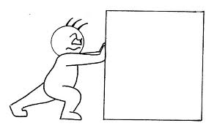
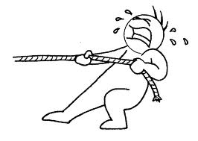
Why do prices rise?
Task: Brainstorm in twos why prices might rise in an economy.
Cost-push inflation
An increase in the cost of production forces firms to increase their prices to protect profit margins.
Demand-pull inflation
There is a higher demand for goods/services and not enough supply to meet it. This leads to an increase in prices.

Slide 20
The Inflationary Spiral
Higher wages
Higher prices

Slide 21
What can businesses do to combat high inflation?
Task: Brainstorm strategies which a business could use to combat high inflation.

Slide 22
What can businesses do to combat high inflation?
Strategy | Evaluation
Cut internal costs to keep price rises down. | This strategy may be painful in term of job losses or restructuring. If improvements in productivity are made, this may come at the cost of investing in capital.
Source from cheaper suppliers. | Will the source of supplies be as reliable as existing suppliers? Will the quality be lower- and could this be indentified by consumers? Potential risk of lost reputation

Slide 23
What can businesses do to combat high inflation?
Cut profit margins by not raising prices as much as costs. | The impact of this strategy may depend of price elasticity of demand for the products Lower profits may hinder future investment and growth plans of the business.
Raise profit margins if inflation is largely caused by ‘demand pull’ pressure – increase prices by more than costs. | The impact of this strategy may depend on price elasticity of demand for the firms products. Elastic products would be affected a great deal. Will consumers resent firms taking advantage of economic conditions?

Slide 24
What can businesses do to combat high inflation?
Strategies used by firms depend on a variety of factors
such as:
Size of the firm
Economies of scale of the firm
Other economic influences. E.g. Exchange rate. Market conditions.
Competitiveness of the market. E.g. Is it an oligopoly?
Etc.

Slide 25
When Inflation falls....
Fall in inflation rate
Reduced prices
Fall in inflation rate
Slowing down in the rate of increase

Slide 26
Effects of High Inflation
Interest rates may rise (monetary policy)
Businesses increase prices.
High Inflation
If UK inflation rate higher then the rest of the world then less competitive internationally.
Consumer price sensitivity increases.
Suppliers may increase their prices. (forecasting, cash flow)
Increased likelihood of industrial action for pay rises.

Slide 27
Effects of Low Inflation
Inefficient firms disappear
More time for long term strategic planning.
Interest rates tend to be low.
Low Inflation
Less spending on marketing and administration
More competitive in international market
Greater level of certainty

Slide 28
Questions & Case Study

