Slide 1
The Labour Market Supply
A2 Economics

Slide 2
Aims and Objectives
Aim:
To understand the factors which influence supply of labour.
Objectives:
Discuss current changes in the UK labour market.
Define and describe the labour supply in the UK.
Analyse the effects monetary and non-monetary factors has on the labour supply.
Evaluate the effects monetary and non-monetary factors has on the labour supply.

Slide 3
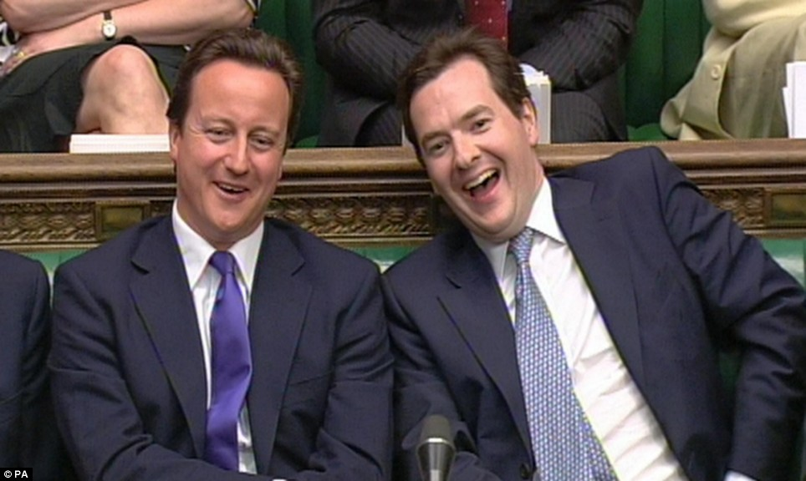
A Labour Challenge for Osborne

Slide 4
Starter
Draw an elastic and an inelastic labour demand curve.
Explain two determinants of elasticity of demand.

Slide 5
The Supply of Labour in the UK
Defining the Labour Supply
Total number of hours that labour is willing and able to supply at a given wage rate
Number of workers willing and able to work in a given occupation or industry for a given wage
The labour force is defined as the number of people either in work or actively seeking paid employment and available to start work.

Slide 6
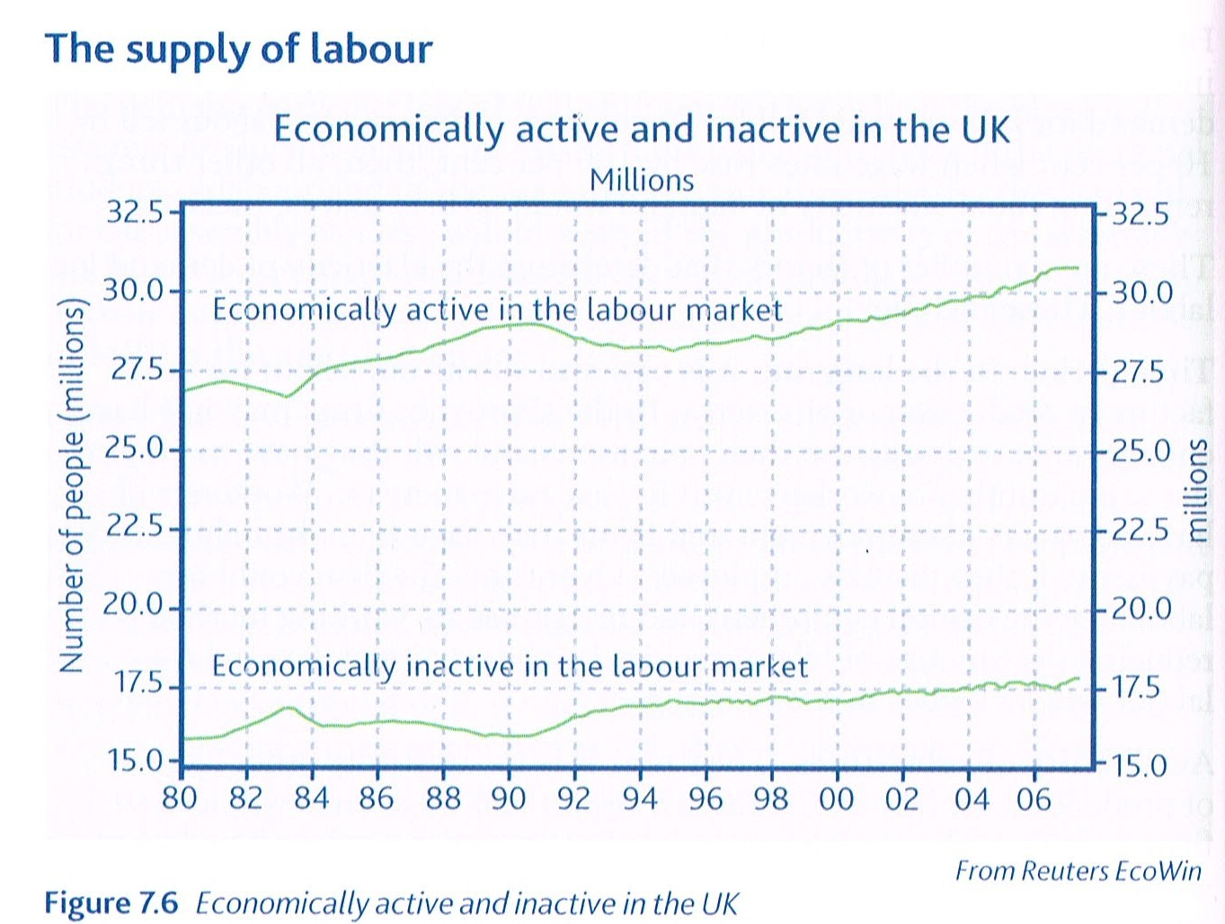
The Supply of Labour in the UK
Economically Active:
People in employment or actively seeking employment.
NOT PART OF THE LABOUR SUPPLY
Economically Inactive:
People who are either not in work nor seeking it.

Slide 7
Determinants of Labour Supply
In groups brainstorm and discuss your ideas of what determines the labour supply level.
Monetary Factors
A
B
C
D
Non-Monetary Factors
A
B
C
D

Slide 8
Monetary Factors
Wage/Salary
Higher the wage, the more people will want to do the job.
Commission
The greater the commission the more people will want to do the job.
Bonus Payments
The higher the bonus payments the more people will want to the job.
e.g. bankers
e.g. lawyers, doctors
e.g. sales

Slide 9
Non-Monetary Factors
Convenience & Flexibility
Long hours may deter people.
Status
People are attracted to jobs with status.
Promotion
People are attracted by promotion opportunities and prospects.
If people can choose their hours or work from home, more willing to work.
Some people may be prepare to work for low wages at first, hoping for higher wages in the future

Slide 10
Non-Monetary Factors
Job Security
Working Conditions
Ceteris paribus, poor working conditions deters people from working in those jobs.
Holiday/Leisure Time
Some people may be attracted to some jobs due to long holidays.
People are attracted to jobs with high levels of security.
e.g. teaching
Eastern European Immigrants and UK

Slide 11
Non-Monetary Factors
Perks/Fringe Benefits
Job Satisfaction
Feeling happy in employment, environment, people, etc.
Company cars, healthcare, discounts etc.
Economic welfare.

Slide 12
Net Advantage
The overall rewards to a particular occupation, taking into account both monetary and non-monetary factors.
Adam Smith argued that this should be equal across the industries in which an occupation exists. E.g. Engineer.
Critique this theory.

Slide 13
Cash for Inner City Teachers
Discuss whether or not teachers at inner city schools should be given cash to work there.
Discuss what monetary and non monetary factors would affect a teachers decision to work in inner-city schools.
Discuss whether you feel cash incentives will encourage ‘good’ teachers to teach in inner city schools.

Slide 14
Plenary
Explain 2 monetary factors which influence the supply of labour
Explain 2 non-monetary factors which influence the supply of labour
Describe the concept of net advantage

