Slide 1
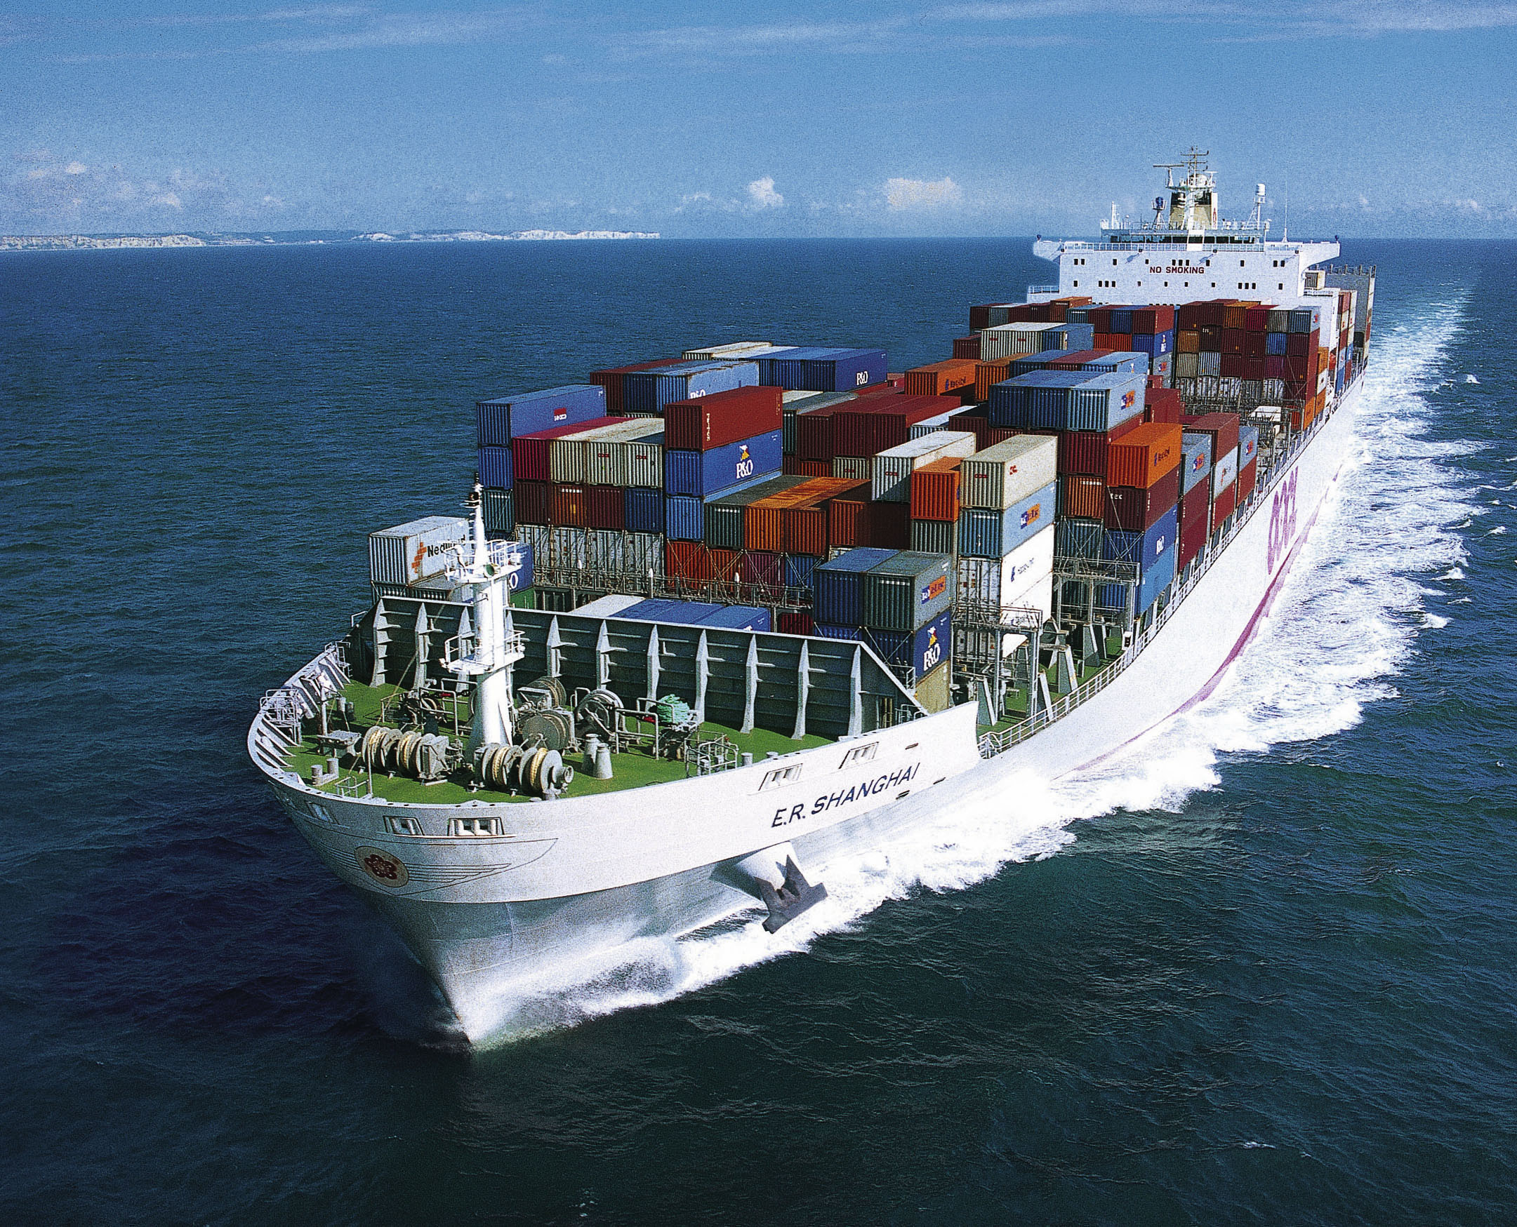
Terms of Trade A2 Economics

Slide 2
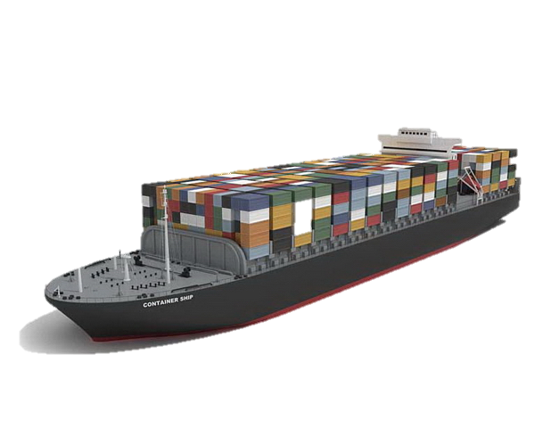
Aims and Objectives
Aim:
Understand the theory of terms of trade.
Objectives:
Describe why countries specialise and trade
Explain the trade process
Critique Ricardo’s theory of comp. adv.

Slide 3
Re-Cap
Comp. adv. theory demonstrates that global resources can be used more efficiently when countries specialise.
Efficiencies can be obtained by importing from countries where the op.cost is lower and concentraing on exporting goods when a comp.adv exists.

Slide 4
Re-Cap
Global specialisation should increase both allocative and productive efficiency and competition should lead to dynamic efficiencies.
Without trade some firms will not be able to benefit from e.o.s and reach the m.e.s.

Slide 5
Terms of Trade – Ricardian Theory

Slide 6
Terms of Trade
 | USA | India
Products | Units Per Hour | Units Per Hour
1 Unit of Food | 6 | 2
1 Unit of Clothing | 3 | 1.5
US can produce more of both goods in less time than India.
US has an absolute adv. in both goods.
Comparatively US three times as productive in food, but only twice as productive in clothing.

Slide 7
Terms of Trade
Therefore, the US should specialise in food and India in clothing (its least comparative disadvantage).
If both countries traded and specialised both countries would benefit and production would be more efficient.

Slide 8
 | USA | India
Products | Units Per Hour | Units Per Hour
1 Unit of Food | 6 | 2
1 Unit of Clothing | 3 | 1.5
If the US wanted to trade with India.
USA will only trade if it receives 3 units of clothing for every 6 units of food.
India will only trade if it receives 2 units of food for every 1.5 units of clothing exported.

Slide 9
 | USA Terms of Trade
1 unit of Clothing Imported = 3 Units of Food Exported
India Terms of Trade
2 units of Food Imported = 1.5 Units of Clothes Exported
6 USA food units / 2 Indian Food units = 3 Units
3 USA clothing units x 1.5 Indian clothing units = 4.5 Units
Output/consumption increase:
 | USA | India
Products | Units Per Hour | Units Per Hour
1 Unit of Food | 6 | 2 (3)
1 Unit of Clothing | 3 (4.5) | 1.5
Overall Gain | 1.5 | 1

Slide 10
Assumes Perfect Competition and Free Trade
Assumes constant prices and perfectly mobile factors of production
What about e.o.s?
Ignores currency fluctuations
Doesn’t consider trade embargoes/protectionism
The time period is ignored
Ignores costs of trade, which could eliminate the benefits of specialisation.

Slide 11
Terms of Trade
Food
The terms of trade will lie somewhere between the two production possibility frontiers.
600
500
400
300
USA
200
India
100
0 100 200 300 400
Clothing

Slide 12
Terms of Trade
The terms of trade (TOT) are the ratio between export prices and import prices.
Movement in the TOT will be caused by inflation, or changes in currency values.
Nations average TOT:
(Index of export prices/index of import prices) x100

Slide 13
Terms of Trade
A TOT improving means that more imports are received for a given number of exports.
Either X prices have risen or M prices have fallen.
Effects depends on price elasticity of demand for X and M.
In UK if TOT improves and foreign demand for UK X is elastic then less will be spent on them as their prices have risen.
If at same time UK demand for imports is price elastic then more will be spent on imports.

Slide 14
Terms of Trade & B of P
In UK BofP should improve as long as the PeD for M and X is greater than one or elastic.
Export prices will have fallen and so X should increase and import prices risen.
Marshall-Lerner Condition:
A reduction in the value of sterling will improve the UK balance of payments as long as the sum of the PeD for M and X is greater than 1.

Slide 15
Homework
January 2011
Question 11
Explain the main factors which might help determine the volume of UK exports and imports. (15 Marks)

