Slide 1
Team Working and Motivation

Slide 2
Aims and Objectives
Aim:
Understand different motivation theories
Objectives:
Explain the advantages and disadvantages of teamwork.
Analyse different motivational theories.

Slide 3
Starter
Work in teams to produce the tallest tower out of paper and tape.
The tower must be free standing and not attached to anything or held up.
All teams towers must be standing by the end.
Make a list of the advantages of working in teams and the disadvantages.

Slide 4
Advantages
A feeling of belonging and responsibility to team mates, encouraging employees to meet company standards.
Greater satisfaction from completing jobs.
Usually higher productivity.
Employees able to learn different skills.
Problem solving is easier in teams.
Everyone involved in decision making process leading to high motivation and morale.

Slide 5
Disadvantages
Productivity may fall to the level of the weakest worker.
Decision making process can be slow.
Individual self-worth diminished.
Individual contribution may be over looked.
The success of the team may become more important than the success of the business.

Slide 6
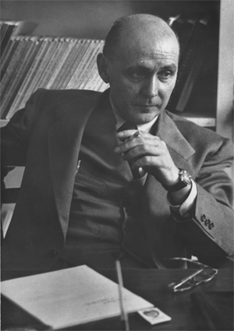
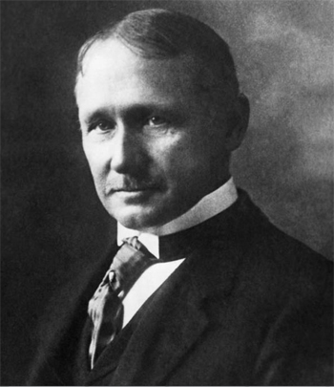
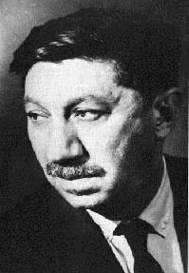
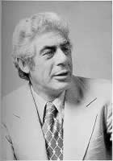
Motivational Theories

Slide 7
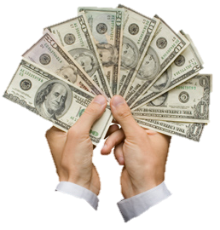
Frederick Taylor
Mass production environment
Assumed only motivator was money
He also discovered the most efficient way to carry out a task – time based management
Believed that any pay scheme should reward those who produced the most – piece rate.
Workers need closely supervising.

Slide 8
Elton Mayo
Looked at how physical factors such as light and heat improve worker’s performance.
He found these made no difference.
It was social interaction and people being valued which increased performance.

Slide 9
Abraham Maslow
Within each person there is a hierarchy of needs and individuals must satisfy each level before they can move onto the next.
Collective Memory Game

Slide 10
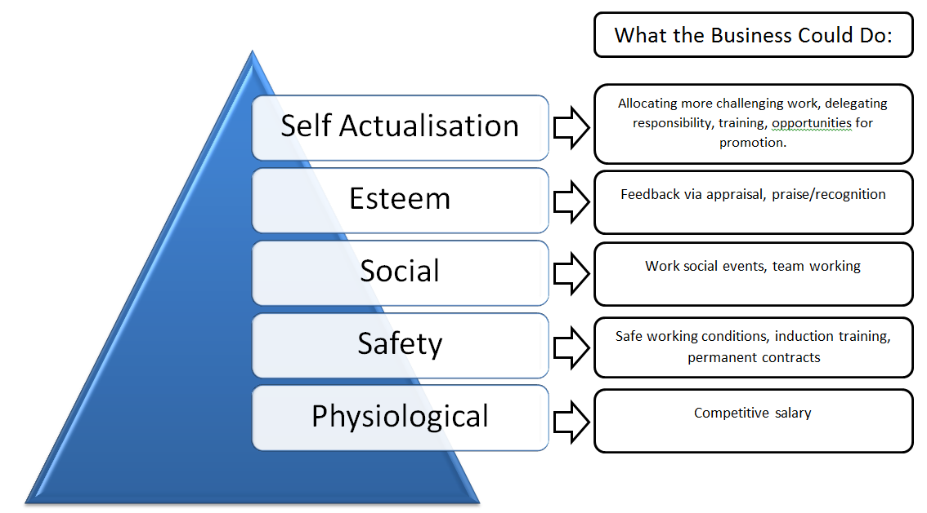
Maslow’s Hierarchy of Needs

Slide 11
Maslow’s Hierarchy of Needs
Maslow suggested that to motivate an individual an employer needed to know where they believe they were in the hierarchy.
Use the next level to motivate.

Slide 12
Frederick Herzberg
Two sets of factors affecting people’s feelings towards work.
Hygiene Factors
Working conditions
How business is run
Motivators
Nature of job role
Recognition
Sense of Achievement
Level of responsibility
Pay
Level of supervision

Slide 13
Frederick Herzberg
Hygiene factors could lead to job dissatisfaction.
Motivators are …….motivating
There are some cross overs (Pay)

Slide 14
Plenary
Having studied the different various theories of motivation, which do you feel is the most credible?
What do you feel you are most motivated by?
Money? Job Satisfaction? Praise?

