Slide 1
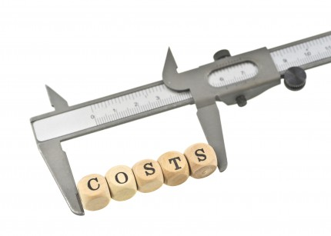
Production In The Long Run
A2 Economics Unit 3

Slide 2
Aims and Objectives
Aim:
Understand long run production.
Objectives:
Define increasing and decreasing returns to scale.
Explain how optimal output can change.
Analyse the effects of economies of scale.
Evaluate short run costs and long run costs.

Slide 3
Starter
Define marginal cost.
Define average total cost.
Explain how the law of diminishing returns works.

Slide 4
Production in Long Run
In the long run a firm can temporarily overcome dim.ret. as it can vary its fixed factors.
E.g. it could move to a larger premises.
But dim.ret. sets in again when the premises get too small –overloaded.
Occurs beyond optimal output.

Slide 5
Optimal Output Changing
ATC Per Unit £s
ATC
ATC1
ATC2
ATC3
0
A
B
Output

Slide 6
Diagram Explained
Different combination of fixed and variable factors.
Separate SR ATC curve for every level of output.
Firm producing at output 0A is producing at lowest point on ATC.
0B high level of output with lower costs.

Slide 7
Increasing Returns to Scale
At each SR ATC curve increasing returns to scale are occurring.
Due to the ability of firms to increase all factors of production.
Therefore in the LR there are no fixed factors!
Where an increase in factor inputs leads to a more than proportionate increase in outputs.

Slide 8
LRATC Curve – Falling LR Costs
ATC
LRATC Per Unit £s
Increasing returns to scale.
LRATC slopes downwards due to economies of scale.
ATC1
ATC2
ATC3
LRATC
0
Output

Slide 9
Economies of Scale
Returns to scale only occurs up to a point.
Economies of Scale
Diseconomies of Scale
LRATC Per Unit £s
LRATC
LRATC
MES
0
Output

Slide 10
Decreasing Returns to Scale
Where an increase in factor inputs leads to a less than proportionate increase in factor outputs.
Results in diseconomies of scale.

Slide 11
Constant Returns to Scale
Where an increase in factor inputs leads to a proportional increase in factor outputs.
LRATC Per Unit £s
Economies of Scale
Diseconomies of Scale
Constant Returns to Scale
LRATC
0
A
B
Output

Slide 12
Minimum Efficient Scale
This is the lowest point on the LRATC curve and also shows productive efficiency.
Firms that cannot meet the MES are unlikely to be competitive with other firms.

Slide 13
Questions
Why can you now buy a high-performance laptop for just a few hundred pounds when a similar computer might have cost you over £2,000 just a few years ago?
Why is the average price of digital cameras falling all the time whilst the functions and performance level are always on the rise?
How can IKEA profitably sell flat-pack furniture at what seem impossibly low prices?

Slide 14
Answer
ECONOMIES OF SCALE
MORE FIRMS REACHING THEIR MES!

Slide 15
Short Run Vs Long Run
Unit Cost £
SRATC
SRATC1
LRATC
0
A
B
Output

Slide 16
Diagram Explained
Firm producing at 0A lowest point on SRATC curve.
Firm increases output to 0B perhaps due to an unexpected rise in demand.
Costs increase up the SRATC curve due to ‘overloading’.

Slide 17
Diagram Explained
Firm decides to increase its fixed factors.
Firm moves to SRATC1, until it reaches LRATC at point 0B.
Productive Efficiency.

Slide 18
Plenary
Construct a diagram to explain how a firm might react to a substantial increase in the demand for its product.
Explain in terms of the diagram how the firm could overcome the problems it now faces.
Why might a firm take no action?

