Slide 1
Oligopolies
A2 Economics

Slide 2
Starter:
Draw the two Oligopoly diagrams Critique the theory, with 2 criticisms.

Slide 3
Homework Back
Common mistakes: definitions, application (refer to facts and figures in text to back your point up).
Things to work on.
Overall, they were good.

Slide 4
Supermarkets-Oligopoly Discussion

Slide 5
Aims and Objectives
Aim:
To understand the Prisoner’s Dilemma.
Objectives:
Analyse the Supermarket Oligopoly.
Define Game Theory
Describe the Prisoner’s Dilemma.
Simulate the Prisoner’s Dilemma.
Analyse Prisoner Dilemma outcomes.
Evaluate the banking sector as an oligopoly.

Slide 6
Game Theory - Oligopolies
Interdependent firms have to be able to predict what changes their rivals are likely to make.
Firms must have strategies in place to respond to competitors actions.
Interdependent firms also must consider how rivals will react to their actions and strategies.

Slide 7
Game Theory - Oligopolies
The reactions of one player in the market, to changes in strategy by another.
Game Theory: is a zero sum game. (where a gain by one player is matched by a loss by another player).
Firms are risk averse. (They avoid risk).

Slide 8
The Prisoner’s Dillema
Game Theory supports collusion, through a model known as the Prisoner’s Dilemma.

Slide 9
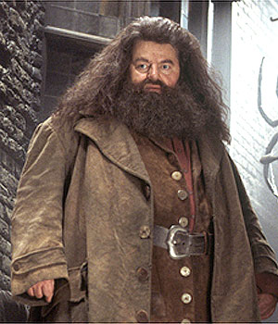
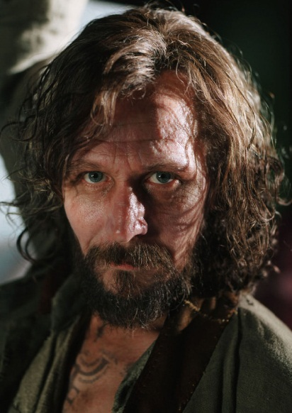
Prisoner’s Dillema.
Two prisoners, Mr A and Mr B
Mr A Mr B

Slide 10
Prisoner’s Dilemma
Both are accused of committing a joint crime.
But kept apart in different cells to prevent collusion.
They are informed that if they both plead innocent, they will receive a light sentence.

Slide 11
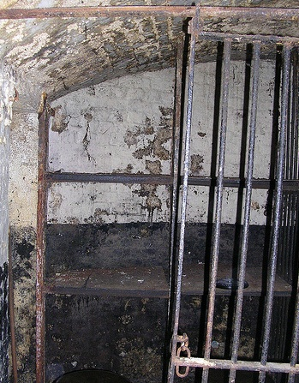
Prisoner’s Dilemma
But…if one pleads innocent and the other owns up to being guilty, the one pleading innocent will receive a long sentence, and the one admitting guilt will be let off.
If they both plead guilty they get a medium sentence.

Slide 12
PRISONER A
 | Innocent | Guilty
Innocent | Mr A: Light sentence Mr B: Light sentence. | Mr A: No sentence Mr B: Long sentence
Guilty | Mr A: Long sentence Mr B: No sentence | Mr A: medium sentence Mr B: medium sentence
PR I SONER
B

Slide 13
Prisoner’s Dilemma. You Decide.
Group 1 Group 2
Hagrid Sirius Black

Slide 14
Both Prisoners Plead Guilty. Pareto Efficiency (the most efficient outcome)
If they could collude, and both agree to plead innocent, they would get a light sentence.
However they are unable to collude.
They cannot trust each other, and both plead guilty.

Slide 15
Why do both plead guilty?
Mr A (Hagrid) reasons as follows:
Mr B (Sirius Black) will either plead guilty or innocent.
If Mr B (Sirius Black) pleads innocent: Mr A (Hagrid) gets a light sentence if he also pleads innocent.
But Mr A (Hagrid) receives no sentence at all if he pleads guilty. So….Guilty is Mr A’s preferred plea.

Slide 16
Why do both plead guilty?
If Mr A (Hagrid) assumes Mr B (Sirius Black) pleads guilty, Mr A (Hagrid) gets a severe sentence if he pleads innocent, and a medium sentence if he pleads guilty.
Therefore guilty is Mr A (Hagrids’) preferred plea.
Mr B (Sirius Black) thinks in the same way, and as a result they both plead guilty and get a medium sentence in Azkaban.

Slide 17
Prisoners Collude Over Lunch in Azkaban
Hagrid and Sirius Black, decide on a strategy together.
You decide which the best outcomes for both are…..
If both prisoners can collude, they can both plead innocent and get a light sentence.

Slide 18
Plenary: Banking Sector

