Slide 1
Price Discrimination
A2 Economics

Slide 2
Aims and Objectives
Aim:
To understand price discrimination.
Objectives:
Analyse a cartel.
Describe the advantages and disadvantages of cartels.
Examine price discrimination in practice.
Analyse price discrimination using economic models.
Evaluate the reasons why firms price discriminate.

Slide 3
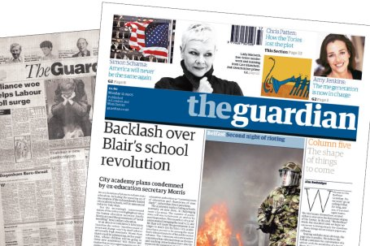
Independent Schools Running a Cartel.
Guardian Article

Slide 4
Starter: Cartels, For and Against
Case for and against cartels
Two teams
5 mins prepare
5 mins argue

Slide 5
Wal-Mart and Price Discrimination in the USA

Slide 6
Price Discrimination
Price Discrimination: ‘Firms charging different prices to different customers based on differences in the customers ability and willingness to pay.’

Slide 7
Price Discrimination
Customers who are prepared to pay more are charged a higher price than those only willing to pay a lower price.

Slide 8
Perfect Price Discrimination
Occurs when a firm charges each customer the maximum price the customer is prepared to pay.
Customers end up with zero consumer surplus.
All transferred to seller of good as extra profit.
Outcome close to perfect price discrimination occurs with customers and street sellers.

Slide 9
Monty Python Perfect Price Discrimination

Slide 10
Gatecrasher Traffic Light Party: Price Discrimination
Nightclub divides it’s market into male and female customers.
Each with a different elasticity of demand at each price of admission.
Diagram. (Price discrimination when a firm charges different prices to two groups of customers).

Slide 11
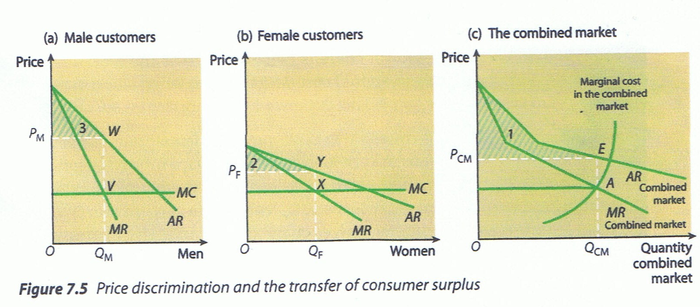

Slide 12
Gatecrasher Traffic Light Party: Price Discrimination
At all the prices that could be charged for entry to the club, female demand is more elastic than male demand.
Females, are less enthusiastic about going to the club.
Female demand is more elastic than male.
D=MR is twice as steep as D=AR.
MC when an extra person enters the club is the same. (Vertical MC Curve).

Slide 13
Gatecrasher Traffic Light Party: Price Discrimination
Profit Maximise: MC=MR in both male and female markets.
Men pay a higher price of PM.
Women pay a lower price of PF.
QM males are allowed into the club.
QF females are allowed into the club.

Slide 14
Gatecrasher Traffic Light Party: Price Discrimination
Different prices charged result from the different male and female price elasticities of demand.
Note that the last MR received from the last man and woman admitted are the same.

Slide 15
Conditions For Price Discrimination
Must be possible to identify different groups of customers. Possible when customers differ in their knowledge of the market.
At any particular price, the different groups must have different elasticities of demand.
Markets must be separated to prevent seepage. Seepage takes place when customers buying in one market at a lower price resell in another market at a price which undercuts the oligopolists own selling price.

Slide 16
Why do firms price discriminate?
Diagram (Price Discrimination and the transfer of consumer surplus).
Price discrimination allows firms to increase profit by taking consumer surplus away from consumers and converting it into supernormal profit.
Shows combined market with the male and female D=AR curves added together.
D=MR added together.
MC curve slopes upwards to reflect law of diminishing returns.

Slide 17
Why do firms price discriminate?
In the absence of price discrimination all consumers pay the same price (PCM).
Without price discrimination consumer surplus is shown by the shaded area labelled (1).
But with price discrimination when males are charged PM and females are charged PF, consumer surplus falls to the areas marked (2) and (3).
Firms’ profit has increased by transferring consumer surplus from consumer to producer.

Slide 18
Plenary:
Define price discrimination.
Team teach each other the diagrams and explanations of the diagrams.

