Slide 1
Production Possibility Boundaries
AS Economics

Slide 2
Aims and Objectives
Aim: | Understand how PPB curves can shift
Level | Objectives:
E-D | Define productive potential
C-B | Explain how an economy's productive potential can change
B-A | Analyse the effects of a change in the factors of production on the PPB
A* | Evaluate different factors effects on the PPB of an economy

Slide 3
Starter
Draw an economy producing an equal number of capital goods and consumer goods.
Show productive efficiency on your diagram.
Explain allocative efficiency.

Slide 4
Discussion
GB settled in Australia in 1770.
Increase in four factors of production.
GB now had the potential to increase its output of goods and services.
What may have happened to its’ PPB curve?

Slide 5
Shifting the PPB
The capacity of the economy to produce more has increased.
The potential to produce more goods and services has increased.
Goods
C
A
PPB1
PPB2
0
B
D
Services

Slide 6
Increasing Productive Potential
What factors may increase the economy’s potential ability to produce more goods/services?

Slide 7
Increasing Productive Potential
Increase in Land
Allows new production possibilities
Increase in Labour
Increase in immigration potentially allows us to produce more.
Improving Technology
New technologies help to produce more efficiently and raise productivity.
Allowing more goods/services to be produced.
Encouraging Enterprise
Providing grants and finance to start up businesses.

Slide 8
Improving Human Capital
Investing in training to improve the skills of the workforce will increase the economy’s productive potential.
Investing in Human Capital.
http://news.bbc.co.uk/1/hi/programmes/the_daily_politics/7934729.stm
An attempt to increase the PPB of the economy or to keep unemployment figures down?

Slide 9
Managing Human Capital
Adam Smith
Observed a pin factory
When production is divided into specific tasks, output rose significantly.
Division of Labour & Specialisation
Division of Labour
Breaking the production process down into a sequence of tasks, with workers assigned to particular tasks.

Slide 10
Managing Human Capital
Specialisation
The production of a limited range of goods by an individual factor of production, in cooperation with others so that a range of goods is produced.
http://www.youtube.com/watch?v=DfGs2Y5WJ14
http://www.youtube.com/watch?v=5cL60TYY8oQ
Division of Labour in 21st Century

Slide 11
Shifting the PPB
If efficiency and productivity increases in the production of one good PPB shifts as opposite.
Increase in productive potential of computer games from investment in new technology.
Movement from 0B to 0D
Financial Services
A
PPB1
PPB2
0
B
D
Computer Games

Slide 12
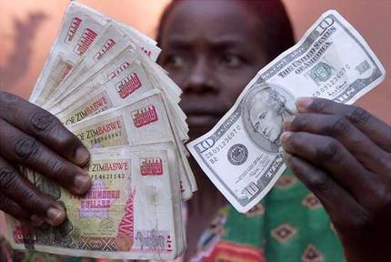
Reduction In Productive Potential
Read through the article on the Zimbabwean economy, highlight anything that may shift the PPB to the left.
http://www.bbc.co.uk/news/world-africa-14445087

Slide 13
Shifting the PPB
The capacity of the economy to produce has decreased.
The potential to produce goods services has decreased.
Goods
C
A
PPB2
PPB1
0
B
D
Services

Slide 14
Value Judgements
Statements or opinions expressed that are not testable or cannot be verified and depend very much on the views of the individual and the values they hold.
We should ban smoking completely
We should bring back the death penalty
Britain should leave the EU.

Slide 15
Normative Statement
Opinions that require value judgements to be made.
They cannot be proven or tested.

Slide 16
Normative Statement
Opinions that require value judgements to be made.
They cannot be proven or tested.

Slide 17
Positive Statement
Statements that can be tested against real-world data.
If the government increases taxes then total demand for consumer goods will fall.

Slide 18
Activity
Explain, using a diagram in each case, the likely effect of the following on the PPB:
An improvement in the available technology for producing consumer goods only.
A hurricane that destroys approximately 5% of all factories and production facilities.
A decision by individuals to allocate more resources towards producing consumer goods at the expense of producing capital goods.

Slide 19
Plenary

