Slide 1
Perfect Competition
A2 Economics

Slide 2
Aims and Objectives
Aim:
Understand perfectly competitive markets
Objectives:
Define perfect competition
Explain the assumptions made about perfectly comp. firms.
Analyse the price taking behaviour in these markets
Evaluate the impacts of changes in these markets

Slide 3
Starter Quiz Questions
Explain the divorce of ownership and control.
Explain the law of diminishing returns.
Define productive efficiency.
Explain the difference between profit maximising and profit satisficing.
Describe three forms of firm growth.

Slide 4
The Market Spectrum
Perfect Competition: large number of small firms.
Oligopoly: a few large firms dominate the industry.
Monopoly: one firm in an industry.
Duopoly: two dominant firms in a n industry
Monopolistic Competition: Imperfect competition amongst the many.

Slide 5
Perfectly Competitive Markets - Assumptions
Many suppliers each with an insignificant share of market
Each firm is too small to affect price via a change in market supply – each individual firm is a price taker
Identical output produced by each firm – homogeneous products that are perfect substitutes for each other
Consumers have complete information about prices

Slide 6
Transactions are costless - Buyers and sellers incur no costs in making an exchange
All firms (industry participants and new entrants) have equal access to resources (e.g. technology)
No barriers to entry & exit of firms in long run – the market is open to competition from new suppliers
No externalities in production and consumption

Slide 7
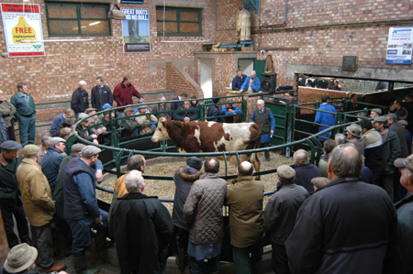
Examples
Rare
Currency Markets
Agricultural Markets
Firms have no influence over the market price

Slide 8
Price Takers
The Market
The Firm
Price of X
Price of X
S
D=AR=MR=P
£5
D
0
0
10
Quantity Demanded and Supplied
In the market price for product X reaches equilibrium at £5.
Individual firm has to accept this price.
If it sells above £5 consumers will go elsewhere.
If it sells below it will have plenty of consumers, but will not be maximising its returns.

Slide 9
Task
From the previous diagram:
Calculate Total Revenue
Calculate Average Revenue
Calculate Marginal Revenue
The demand curve = D = AR = MR = P
Perfectly Elastic as the firm can sell all that it produces at the going price (£5).

Slide 10
Activity
Using the ‘price taker’ diagram assume that more firms enter the industry.
What would happen to the price ruling in the market?
Explain why the individual firm has no option but to trade at that price.
Explain what will happen to the AR and MR and why.
D-E
B-C
A*-A

