Slide 1
National Minimum Wage
A2 Economics

Slide 2
Aims and Objectives
Aim:
Understand national minimum wage.
Objectives:
Define NMW
Explain the NMW rates
Analyse the effects of NMW
Evaluate the merits of NMW

Slide 3
Starter
Define national minimum wage.
What is the minimum wage for those aged 21+?
What is the minimum wage for those aged 18-21?
What is the minimum wage for those aged 16-17?

Slide 4
National Minimum Wage Definition
A minimum amount of money paid to provide a pay floor to low paid workers.
Rationale is to achieve a more equitable distribution of income by raising wages of those on low pay.
Hoped that helps workers escape the unemployment trap by providing a greater incentive to work!
Does this work?
http://www.bbc.co.uk/news/10172407

Slide 5
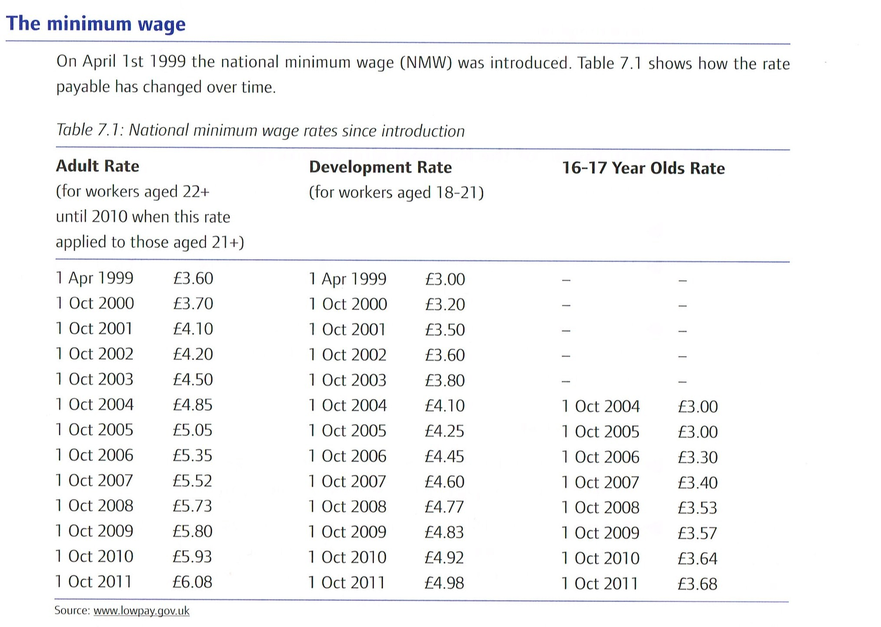
National Minimum Wage

Slide 6
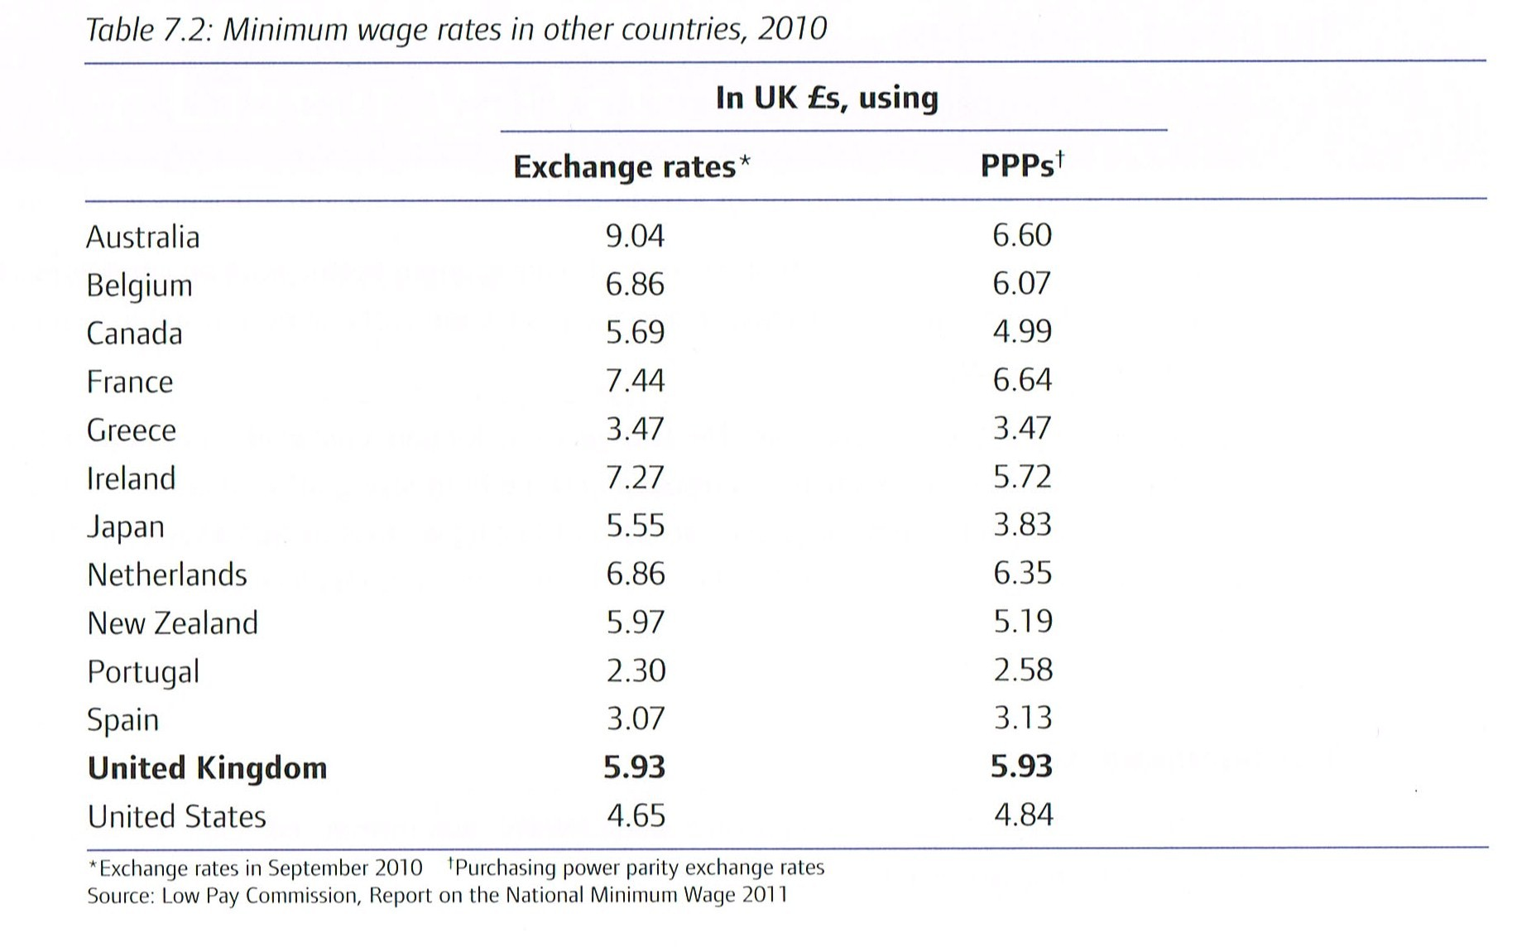
National Minimum Wage

Slide 7
Case For and Against NMW
You are working for the Labour Force Survey department for HM Treasury.
You have been asked to debate the advantages of NMW and the drawbacks of NMW.
You must then decide which argument you feel is stronger.

Slide 8
Minimum Wage Argument : In Favour
Helps reduce poverty for those whose pay it increases.
Male-female wage inequalities are reduced as mostly females who are on low pay.
Increases the incentive to work, reducing voluntary unemployment.
Once incentivised workers pay income tax, and no longer take benefits.

Slide 9
Minimum Wage Argument : In Favour
Workers may receive a morale boost, making them more productive, leading to an increase in labour demand.
Should reduce labour turnover rates, as workers on higher wages will be less likely to look elsewhere.
Can help counter power of monopsonist employer much in same way as trade unions can.
Can generate a multiplier effect seeing as the low paid have a higher Marginal Propensity to Consume. May lead to job creation due to higher derived demand.

Slide 10
Minimum Wage Argument : In Favour
Workers may receive a morale boost, making them more productive, leading to an increase in labour demand.
Should reduce labour turnover rates, as workers on higher wages will be less likely to look elsewhere.
Can help counter power of monopsonist employer much in same way as trade unions can.
Can generate a multiplier effect seeing as the low paid have a higher Marginal Propensity to Consume. May lead to job creation due to higher derived demand.

Slide 11
Minimum Wage Argument : Against
May lead to a loss of jobs.
NMW must be set above equilibrium to have an impact.
NMW raises the MCL causing contractions of demand.
Higher wage also stimulates labour supply, where the result is excess supply.

Slide 12
Minimum Wage Causing Unemployment
Real Wage
Real Wage
Excess Supply
SI
Excess Supply
SE
NMW
DE
DI
Quantity of Workers
Quantity of Workers
Unemployment minimised if S and D are inelastic.
Unemployment is large if S and D are elastic.

Slide 13
Minimum Wage Argument : Against
Unemployment due to NMW may affect young workers the most whose inexperience makes them less productive. This is why NMW for young people is lower!
NMW does a poor job or alleviating poverty because it is poorly targeted.

Slide 14
Minimum Wage Argument : Against
Higher costs for businesses of NMW may be passed onto consumers.
Setting a national minimum wage fails to take into account differences in cost of living in different regions.
Workers not on minimum wage may seek higher wages to restore their relative level of pay. This may be inflationary meaning the NMW may have to rise again!

Slide 15
Plenary
Is NMW a good thing or not?

Slide 16
Exam Question
Do you agree that if a trade union persuades employers to increase wage rates in a labour market, employment must inevitably fall in that labour market? Justify your answer.
(30 marks)

