Slide 1
Market Analysis Moving Averages
A2 Business Studies

Slide 2
Starter
‘Mallet of Panic’
Topic 1: Species of British Wildlife
Topic 2: Brands of Confectionary
Topic 3: Marketing Key Terms

Slide 3
Aims and Objectives
Aim:
To understand Moving Averages.
Objectives:
Define and explain Moving Averages
Describe the use of Moving Averages.
Analyse the usefulness of Extrapolation

Slide 4
Moving Averages
Definition:
A technique for identifying an underlying trend by smoothing out fluctuations in sales data.
Fluctuations may be caused by seasonal demand etc.

Slide 5
Three Month Moving Average
Method:
Add together three consecutive months data.
Calculate an average.

Slide 6
Method
Month | Sales (£000s) | Calculation | 3 Month Moving Average
January | 24
February | 27
March | 29
April | 29
May | 32
June | 27

Slide 7
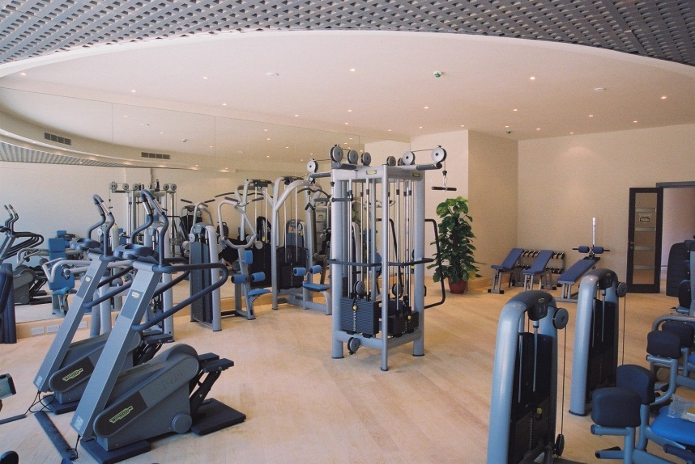
Case Study
4Sport Gym

Slide 8
4Sport Gym
Month | Sales (£000s) | Calculation | 3 month Moving Average
January | 24
February | 27 | (24+27+29) / 3 | 26.6
March | 29 | (27+29+29) / 3 | 28.3
April | 29
May | 32
June | 27
July | 31
August | 32
September | 34
October | 38
November | 39
December | 39

Slide 9
Task 1
Month | Sales (£000s) | Calculation | 3 month Moving Average
January | 24
February | 27 | (24+27+29) / 3 | 26.6
March | 29 | (27+29+29) / 3 | 28.3
April | 29 | (29+29+32) / 3 | 30
May | 32 | (29+32+27) / 3 | 29.3
June | 27 | (32+27+31) / 3 | 30
July | 31 | (27+31+32) / 3 | 30
August | 32 | (31+32+34) / 3 | 32.3
September | 34 | (32+34+38) / 3 | 34.6
October | 38 | (34+38+39) / 3 | 37
November | 39 | (38+39+39) / 3 | 38.6
December | 39

Slide 10
Task 2
Fluctuation 2

Slide 11
Task 3
The Present
The Future

Slide 12
Three Month Moving Averages
Takes out variations in financial figures.
Eg. Seasonal factors.
Timescale ie. 3 month/ 4 month/ 12 month depends on nature of business.
Supermarkets use short time periods.
Construction firms use longer time periods.

Slide 13
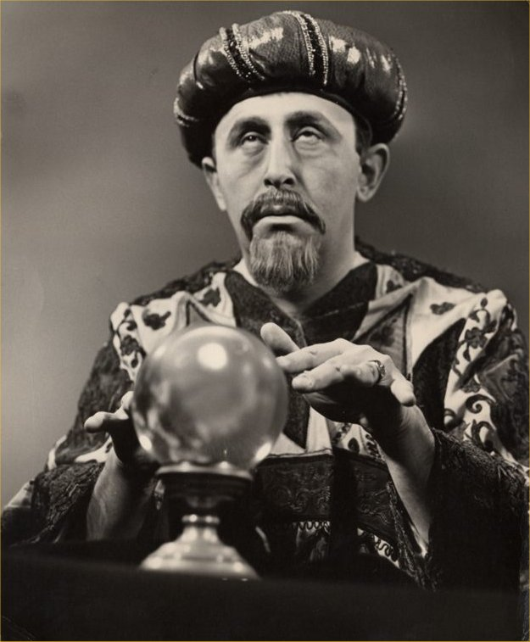
Extrapolation
Taking past and present data about a market and using an identified underlying trend to predict future sales.

Slide 14
Benefits & Drawbacks of Extrapolation
In groups decide on your whiteboards on the benefits and drawbacks of extrapolation.
You may wish to consider the following:
Budgets, motivation
Objective setting
Pitfalls of prediction
Type of market the business is in

Slide 15
Benefits and Drawbacks of Extrapolation
Benefits
Can provide information for the setting of functional/corp. objectives.
Aid the setting of budgets and workforce planning.
Drawbacks
Prediction relies on the past.
Fine in slow moving markets.
Can be misleading in fast paced markets such as technology where constant R&D is required.

