Slide 1
Marketing Objectives
A2 Business Studies Unit 3

Slide 2
Aims and Objectives
Aim:
Understand internal and external factors affecting marketing objectives.
Objectives:
Provide SMART objectives for Virgin Trains.
Explain how internal and external factors affect marketing objectives.
Design SMART objectives.

Slide 3
Starter
Define marketing objectives
What does SMART mean in relation to marketing objectives?

Slide 4
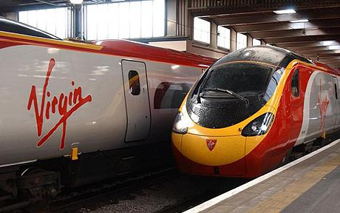
Virgin Trains
Virgin Trains SMART objectives

Slide 5
Internal & External
Internal and External factors both affect the setting of Marketing Objectives.
Complete in teams, and rotate.
Internal/External Factor | How it Affects Marketing Objectives

Slide 6
Internal & External
Internal | How it Affects Marketing Objectives
Finance | Budget, return on investment.
Human Resources | Depends on skills of workforce.
Operational Issues | Quality, Capacity in production.
Corporate Objectives | Are the marketing objectives in line with Corporate Objectives?

Slide 7
Internal & External
External | How it Affects Marketing Objectives
Competitors Actions | Will competitors copy or compete on another measure – price?
Market Factors | Economic Environment, Social Changes, Laws, Consumer Demands
Technological Change | New technology can reduce costs, however can result in short product life cycles

Slide 8
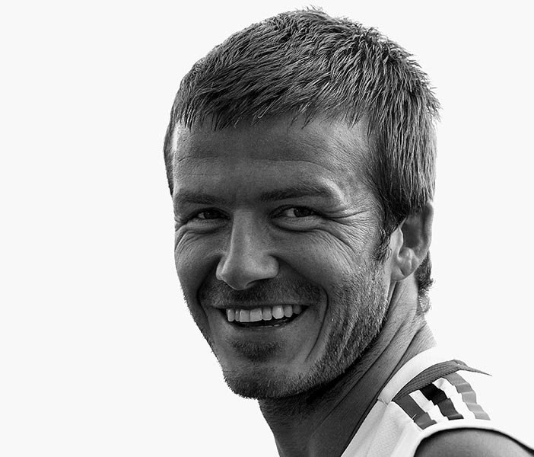
Impacts on Marketing Objectives
In 2003 David Beckham moved from Manchester United to Real Madrid for £25m.
How might this transfer have affected the marketing objectives of both Man Utd and Real Madrid?
Is this an internal or external factor?

Slide 9
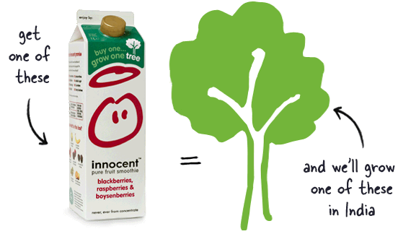
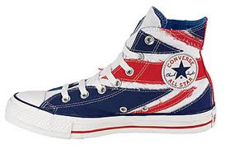
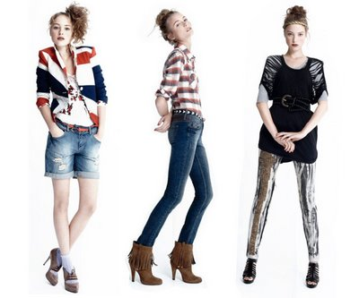
Marketing Objectives
Draft out two SMART objectives which you wish to achieve for your client in your groups.
Feedback/Group Critique

Slide 10
Mood Boards
A collection of images and words that capture recent/future trends which will be used to influence your marketing campaign.
Conveys colours and ideas.
Brainstorm out ideas for colours/trends to include in your marketing.

Slide 12
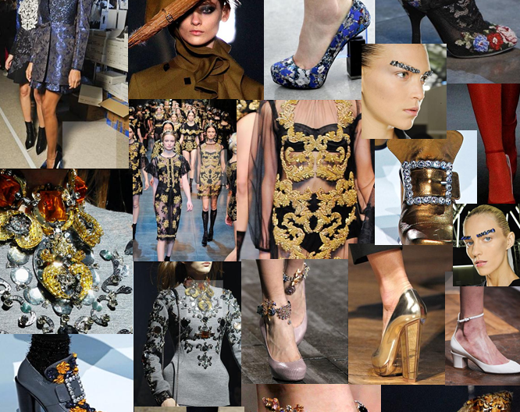

Slide 13
Plenary
Give four internal influences on marketing objectives.
Give four external influences on marketing objectives.

