Slide 1
Start-Up Market Research
AS Business Studies

Slide 2
Aims and Objectives
Aim:
Understand quantitative and qualitative data
Objectives:
Define quantitative and qualitative data
Explain different methods of quantitative and qualitative data
Analyse quantitative and qualitative data
Evaluate which method is more appropriate for different businesses

Slide 3
Starter
Define primary research.
Define secondary research.
Give two examples of each.
Give an advantage of using primary research.
Give a disadvantage of using secondary research.
Which method should a business use and why?

Slide 4
Quantitative Data
Data in numerical form. Is usually collected from larger scale research in order to generate statistically reliable results.
Questionnaires
Telephone surveys
Online surveys
Market share
Market size

Slide 5
Qualitative Data
Data about opinions, attitudes and feelings. It is usually expressed in terms of why people feel or behave the way they do.
In depth interviews
Group discussions

Slide 6
Quantitative or Qualitative Data
Which data should a business collect in their market research?
Depends on the type of business!
A mixture of both to gain a full representation of the market.

Slide 7
JD Sports Qualitative and Quantitative Data
Questions:
What methods of collecting quantitative and qualitative data does JD Sports use that a start-up business could use and alter to suit its needs quite easily?
What methods of collecting quantitative and qualitative data does JD Sports use that a start-up business would struggle to use?
What other methods could a start-up business use to collect quantitative and qualitative data?
How might sampling, reduce a businesses’ market research costs?

Slide 8
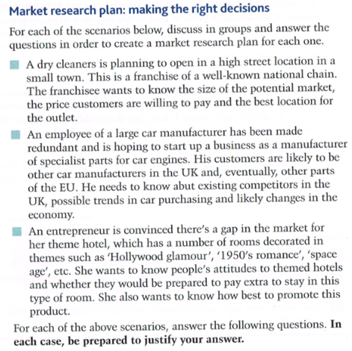
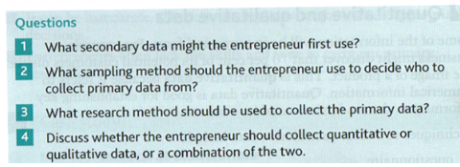
Market Research Plan

Slide 9
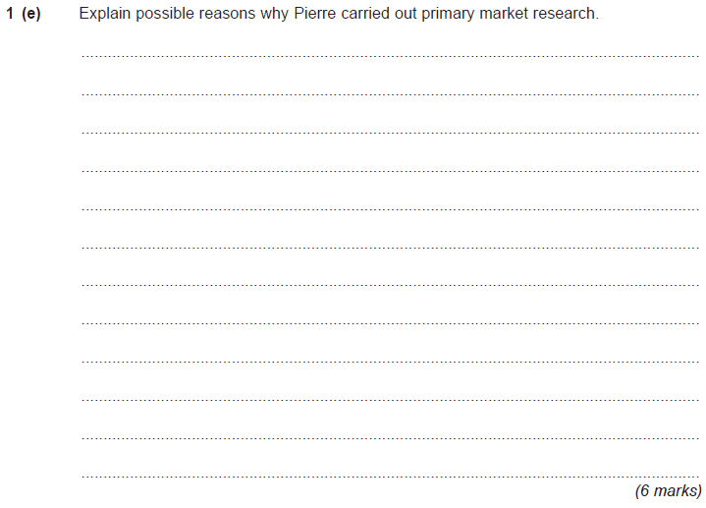
6 Mark Exam Question January 2012

Slide 10
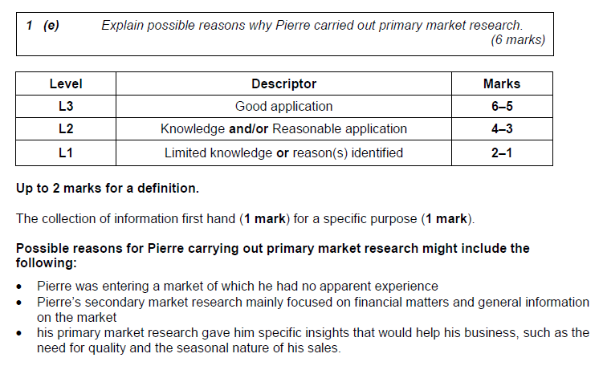
6 Mark Exam Question January 2012

Slide 11
Plenary
Define quantitative data
Define qualitative data
Give two examples of each
Which method is better and should be used by businesses?

