Slide 1
Income and Wealth Inequalities
AS Economics

Slide 2
Aims and Objectives
Aim:
Understand how income and wealth inequalities cause market failure.
Objectives:
Define income, wealth and equity
Describe how market failure is caused
Analyse what can be done by governments

Slide 3
Starter
Define income
Define wealth
Define equity

Slide 4
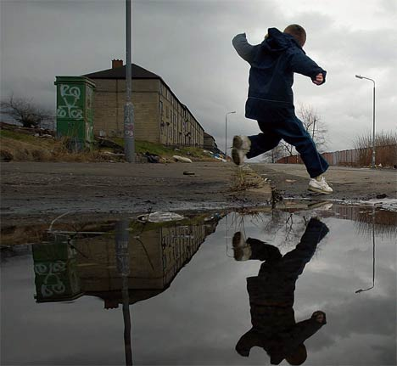
Wealth gap ‘widest in 40 years’

Slide 5
Inequalities in the UK
In the UK, distributions of income and wealth are both unequal.
Distribution of wealth is significantly more unequal than the distribution of income.
The relationship between wealth and income explains this to an extent.

Slide 6
Income and Wealth Inequalities
Better off people have high incomes, and investment incomes (dividends from shares etc), part of which is being saved and added to wealth, which generates even more income.
The poor have low incomes or benefits that are too low to allow saving and wealth accumulation.

Slide 7
TAX System
Tax Rate | Earning Rates
20% | £0 - £35,000
40% | £35,001 - £150,000
50% | £150,000 +
Tax system hits income harder than wealth.
Used to be a 10% rate as well.
We tax the richest hardest, in an attempt to re-distribute wealth.

Slide 8
Re-distribution of income/wealth
Tax Citizens
Use tax revenue to build hospitals/ schools
Poorest in society benefit the most from consumption of hospitals and education.

Slide 9
Market Failure
A free market leads to a highly unequal distribution of income and wealth.
Some economists argue that people who end up being rich deserve to be and people who end up poor deserve to be.
A lack of fairness or equity in the distribution of income and wealth can be seen as a failure of the free market.

Slide 10
Mapping Poverty in the UK
You are working as a team of economists.
Using the data pack provided to you by your secretary.
Analyse the data in preparation to discuss with fellow economists.

Slide 11
What can be done?
When discussing poverty and inequality we are always going to make value judgements.
High levels of inequality and poverty can lead to social issues such as crime.
Solution of poverty and inequalities are value judgements made by politicians…….not economists!
http://www.youtube.com/watch?v=KUY4ztwIVfA&feature=relmfu
What solutions can you think of to re-address the poverty problem in the UK?
http://news.bbc.co.uk/1/hi/programmes/newsnight/8354756.stm

Slide 12
Immobility of Labour and Market Failure
AS Economics

Slide 13
Mobile and Immobile
Define the words:
Mobile
Immobile
Now think how these two words relate to labour (workers).

Slide 14
The Labour Market
For the labour market to function properly, labour must be perfectly mobile.
i.e. Able to move easily between one job and another.
However in reality this is not always possible.

Slide 15
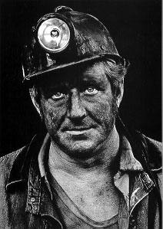
Immobility of Labour
As the economy changes, employment trends change too.
A miner may not be able to easily secure a job as a banker!
The miner is unlikely to have the relevant skills and would need re-training.

Slide 16
Immobility of Labour and Market Failure
Industries such as mining naturally decline, due largely to changes in demand or technologies.
Workers must move occupation to maintain employment, however do not have skills to do so.
This is ‘structural unemployment’.
Market fails as labour is not being fully utilised.

Slide 17
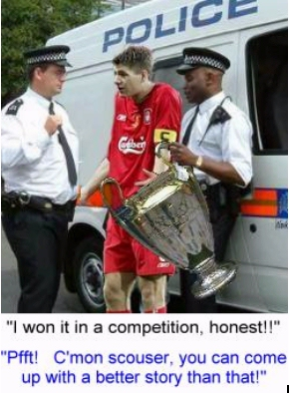
Geographical Immobility of Labour and Market Failure
Income and wealth inequalities are large between Liverpool and Surrey.
How might the immobility of labour have influenced these inequalities?

Slide 18
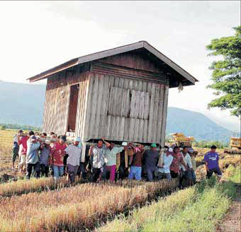
Geographical Immobility of Labour and Market Failure
Labour in one region may not be able to move to another to seek employment.
This is Geographical Immobility of Labour.
Brainstorm reasons as to why labour may not be able to move regions.

Slide 19
Geographical Immobility of Labour and Market Failure
Family Ties
Schooling
Imperfect Knowledge
House Prices
Heritage

Slide 20
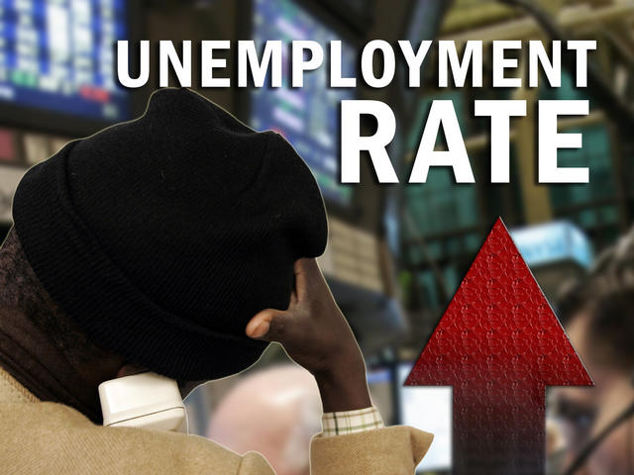
Geographical Immobility of Labour and Market Failure
Geographical immobility of labour therefore means that when employment opportunities in one region decline, workers are unable to move to a region where there are more opportunities.
Unemployment may be created leading to a further market failure.

Slide 21
Plenary
Discuss the following:
What could be done to reduce the effects of this market failure and make labour more occupationally and geographically mobile?

