Slide 1
Macroeconomic Policy Objectives
AS Economics

Slide 2
Aims and Objectives
Aim:
Understand two macroeconomic objectives.
Objectives:
Define inflation & balance of payments
Explain policies in relation to inflation and B of P
Analyse the effects of deflation and hyperinflation
Evaluate policy trade offs

Slide 3
Starter
Draw out the diagram to show full employment in an economy. Be able to explain why stimulating demand with demand side policies may lead to inflation.
Draw out the diagram to show economic growth occurring due to supply side policies. Does inflation occur?

Slide 4
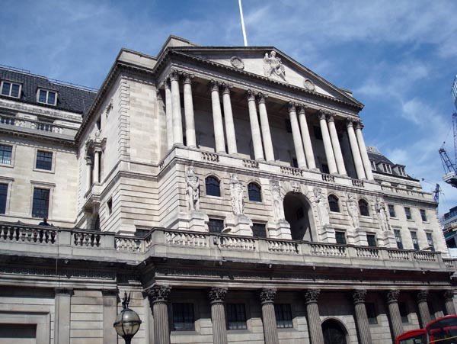
Inflation
OBJECTIVE 3
http://www.bbc.co.uk/news/uk-17026472
UK 2.o% target

Slide 5
Why Try and Control Inflation?
OBJECTIVE 3
Can distort behaviour by economic agents:
1
Consumers spend at increasing rates to try and beat inflation, but in reality this leads to more inflation.
2
Continuing inflation leads to higher savings ratio, contracting demand and potentially causing a recession.
3
Workers demand higher wages, leading to increased costs, and further inflation. SRAS shifts left.

Slide 6
Why Try and Control Inflation?
OBJECTIVE 3
Can distort behaviour by economic agents:
4
Unemployment likely to increase as consumers turn to cheaper imports.
5
Balance of payments deficits will occur!

Slide 7
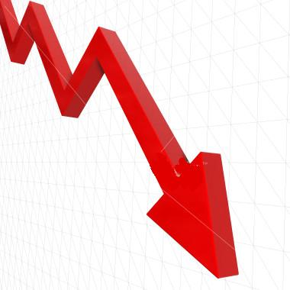
Deflation
OBJECTIVE 3
Inflation is vital to control to be able to concentrate on other policy objectives
Deflation is catastrophic for an economy.
Consumers wait and wait for prices to fall, not buying.
Leads to firms lowering prices to make sales, rising levels of unemployment, and firms liquidating.
Japan

Slide 8
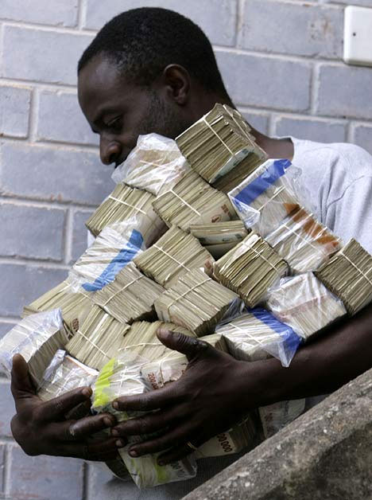
Hyper-Inflation
OBJECTIVE 3
Zimbabwe – Hyperinflation
http://news.bbc.co.uk/1/hi/world/africa/7534190.stm
Report: Riches to Rags
Germany 1923
http://www.youtube.com/watch?v=h-7YCcZUXmw

Slide 9
Balance of Payments
OBJECTIVE 4
A balance is where M = X
Surplus is where X > M
Deficit is where X < M
The aim of increasing the numbers employed, and in the short term increasing economic growth, may clash with achieving a surplus in the balance of payments.
Policy Conflict/Trade Off

Slide 10
Balance of Payments
OBJECTIVE 4
UK and US Deficit
http://www.bbc.co.uk/news/business-12429261
Continuing deficits occurs because:
A shift in the economy towards the service sector
Consumers demanding imported goods
Strong value of £, making imports cheap and exports expensive

Slide 11
B of P Deficits
OBJECTIVE 4
Problem……
Deficit begins to grow, and investors no longer wish to hold money in the UK and foreign banks refuse to lend money.
To overcome this lack of credit…..
Government would have to cut domestic spending to reduce demand for imports.
However…….
There is a policy conflict as it would lead to reduced growth and increased unemployment

Slide 12
Homework
homework
June 2010
Context 2
Questions:
5, 6, 7, 8

