Slide 1
Operational Strategies: Lean Production
A2 Business Studies

Slide 2
Aims and Objectives
Aim:
Understand Kaizen
Objectives:
Define Kaizen
Explain Kaizen
Analyse Kaizen
Evaluate Kaizen

Slide 3
Starter
Define simultaneous engineering and JIT.
Explain how simultaneous engineering and JIT can reduce waste and increase productivity.
What does the success of simultaneous engineering and JIT depend on?

Slide 4
Kaizen
Kaizen (or ‘continuous improvement’) is an approach of constantly introducing small incremental changes in a business in order to improve quality or efficiency.

Slide 5
Kaizen
Process of making small changes to production process.
Ideas come from employees who work on shop floor.
Therefore less likely to be radically different and are easier to implement.
Small improvements less likely to require large capital investments.
All employees should look for ways to continually improve their own performance.
Encourages employees to take ownership for their work which reinforces team working and motivates.

Slide 6
Kaizen Analysis
http://www.youtube.com/watch?v=bZnqWZVEpzs&feature=related
- Improves efficiency and productivity.
- Reduces waste
- Employees feel empowered
- Acts as a motivating tool
- Little capital investment required
- May be conflict between managers and workers ideas.
- If workers ideas are not implemented fully may be demotivating

Slide 7
Kaizen Evaluation
What does the success of implementing Kaizen depend on?
Culture and ethos of the business and the relationship between managers and workers!
Trained and motivated workforce.

Slide 8
Lean Production 18 Mark Question June 2012
Plan on sheet first!

Slide 9
Good Application

Slide 10
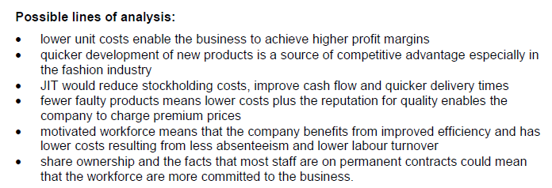
Good Analysis

Slide 11
Good Evaluation

