Slide 1
Internal Causes of Change
A2 Business Studies

Slide 2
Aims and Objectives
Aim:
Understand methods of change
Objectives:
Define retrenchment, MB-O and PEO
Explain the process of each of the above
Analyse the process of each of the above

Slide 3
External Growth Merger Investigation
http://news.bbc.co.uk/1/hi/business/8610124.stm
http://www.bbc.co.uk/news/business-11866666

Slide 4
Should the merger of British Airways and Iberia Airlines go ahead or not?

Slide 5
Retrenchment
The reduction of business costs in order to become more financially stable, increase profits and to move out of loss-making areas of operation.
In groups discuss the benefits and drawbacks of retrenchment.

Slide 6
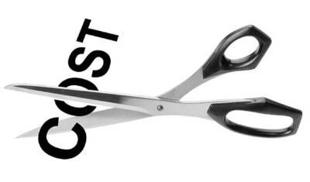
- Could mean the difference between survival and failure
- Could in the long run result in the ultimate success of a business
- Could reduce wastage
- Staff have decreased job security
- Staff morale is affected
- Customers may be lost as products/services withdrawn
- Stakeholders may lose confidence in the business
- Negative publicity may arise from making tough decisions

Slide 7
Easing Retrenchment
To limit the negative effects of retrenchment:
1
Consult with staff and TU on job losses
2
Give clear reasons for retrenchment
3
State when retrenchment will take place
4
Provide and explain assistance given to employees
5
Reassure staff to be retained about job security, salaries etc.

Slide 8
Changes in owners/leaders

Slide 9
Management Buy Outs (MB-O)
Form of ownership where a company’s existing managers acquire a significant part or all of a business.
?

Slide 10
Management Buy Outs (MB-O)
Discuss the advantages and disadvantages of MB-Os.
?

Slide 11
- Managers incentivised to work hard, no divorce between management and control.
- Style of leadership may become more bureaucratic and decision making quicker
- Sale of a division will raise capital for parent company
- Many MB-Os are financed by debt, which makes the new company subject to economic conditions.
- If bought from a parent company will now lose the support and backing of the parent company.

Slide 12
Flotation on Stock Exchange
http://www.bbc.co.uk/news/technology-16845036
Conversion to a PLC
Only feasible if can justify growth plan and need for capital
AIM – alternative investment markets smaller companies
Stock Exchange – larger businesses with history of trading
Discuss the benefits and drawbacks of flotation.

Slide 13
- Rewards success of entrepreneurs
- Allows access to capital for expansion
- Gives higher market value.
- Status of business improved.
- Cost of flotation may too high. Publications etc.
- Divorce of ownership and control could occur
- Greater transparency and disclosure of company details.
- Risk of takeover if 50% or more shares bought.

Slide 14
Private Equity Ownership
When wealthy investors buy out a business which is usually under-performing.
Become privately owned and no longer listed on stock exchange.
Substantial tax benefits – accounts no longer have to be published.
Unions argue that these investors are only interested in short term profits and not jobs.
Owners argue no division of ownership and control and may lead to LR growth.

Slide 15
Private Equity Ownership Firms

Slide 16
Plenary
Define MB-O
Define Flotation
Define Private equity ownership
Provide examples of each of the above

