Slide 1
Improving Organisational Structure
AS Business Studies Unit 2

Slide 2
Aims and Objectives
Aim:
Understand different types of organisational structure.
Objectives:
Define work load, job roles & delegation
Explain communication flows and the problems which can occur in structures
Analyse different types of organisational structure

Slide 3
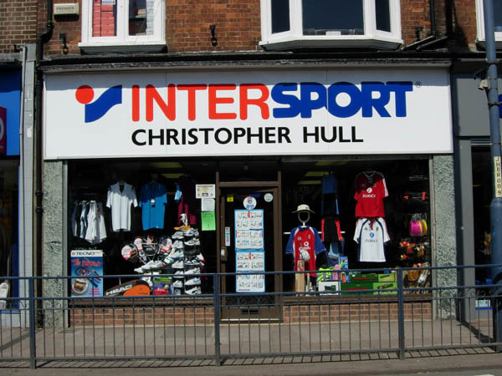
Activity
You are going to work in teams to produce and sell business card boxes for Young’s Sports LTD.
You will have 10 minutes to produce as many boxes as possible.
For each box you will receive €2 plus a financial bonus for logos, slogans, colour.
You must appoint a manager of your team.
Young Sports Ltd

Slide 4
Feedback
Were your managers good managers?
If so, why?
What made your team successful/unsuccessful?
Successful leaders should have considered the following things……….

Slide 5
Work Load
In diagram 1, the work load of managers is likely to be greater than the work load of managers in diagram 2 because they have a wider span of control.
Workers should not be overloaded as this may lead to a worker becoming demotivated, and unproductive.

Slide 6
Job Roles
It is vital that everyone in an organisation knows what the specific tasks and responsibilities of their job are.
Results in increased productivity and increased morale as workers feel confident in the tasks they are doing.

Slide 7
Delegation
Passing authority to make specific decisions to somebody down the hierarchy.
Dividing work load, can make business more efficient and productive.
Workers feel empowered to make decisions.
Workers morale may increase as they feel valued by the business.

Slide 8
Communication Flows
Chinese whispers game.
In small businesses, communication flows should be quick and accurate, usually face to face. Organisational structures are small and flat.
As businesses become larger, their lines of communication get larger, and can become inefficient (communication failures).
To avoid this technology must be used to ensure communication is as effective as it can be.

Slide 9
Why good internal communication is important
Everyone in firm is aware of objectives and what the firm is aiming for.
Customer needs can be met through communicating market research results.
Decision makers are aware of ideas and improvements for the business which could lead to competitiveness.
Decision makers are aware of changes in business environment such as a new competitor entering the market.

Slide 10
Hierarchical Structures
A
B
C
D
E
F
G
H
I
J
Allow specialist job roles to develop
Opportunities for promotion which can be motivational
Managers work load determined by span of control
Communication can be slow affecting decision making

Slide 11
White Board Activity
Draw a hierarchical structure
Give an advantage of having a hierarchical structure
Give a disadvantage of having a hierarchical structure

Slide 12
Matrix Structures
Projects | Marketing | Operations | H/R | Finance
A
B
C
Used for projects which involve teams and functional areas.
Employees encouraged to use their talents through team working which can be motivating.
Work load may be unevenly spread resulting in resentment.
Team members may have motives and loyalties to their departments and not the project.

Slide 13
White Board Activity
Draw a matrix structure
Give an advantage of having a matrix structure
Give a disadvantage of having a matrix structure

Slide 14
Entrepreneurial Structures
Found in small businesses in competitive markets.
Decision making vital to maintain/increase market share
A core team of decision makers supported by team of employees.
Can only really work in a small business.
As businesses grow makes it impossible to manage work load.
Core Team
Employees

Slide 15
White Board Activity
Draw an entrepreneurial structure
Give an advantage of using an entrepreneurial structure.
Give a disadvantage of using an entrepreneurial structure.

Slide 16
Plenary
Decide upon the best structure for the following businesses, there is one red herring!:
Tesco
Small graphic design business
An engineering firm
Estate Agents
BMW
Lawyers

