Slide 1
Employing People
AS Business Studies

Slide 2
Aims and Objectives
Aim:
Understand options for start-up businesses of employing people
Objectives:
Define full time and part time workers
Explain current trends in the UK labour market
Analyse employing full and part time workers

Slide 3
Starter
In October 2012 there were 29.59m people employed in the UK which is 71.3%. There were 2.53m people unemployed, which is a rate of 7.9%. There were 9.04m people who were economically inactive (not seeking or in work) which is around 22.5% and there were 1.57m people claiming job seekers allowance – 4.8%.
For each of the following graphs provide a significant point of comparison.

Slide 4
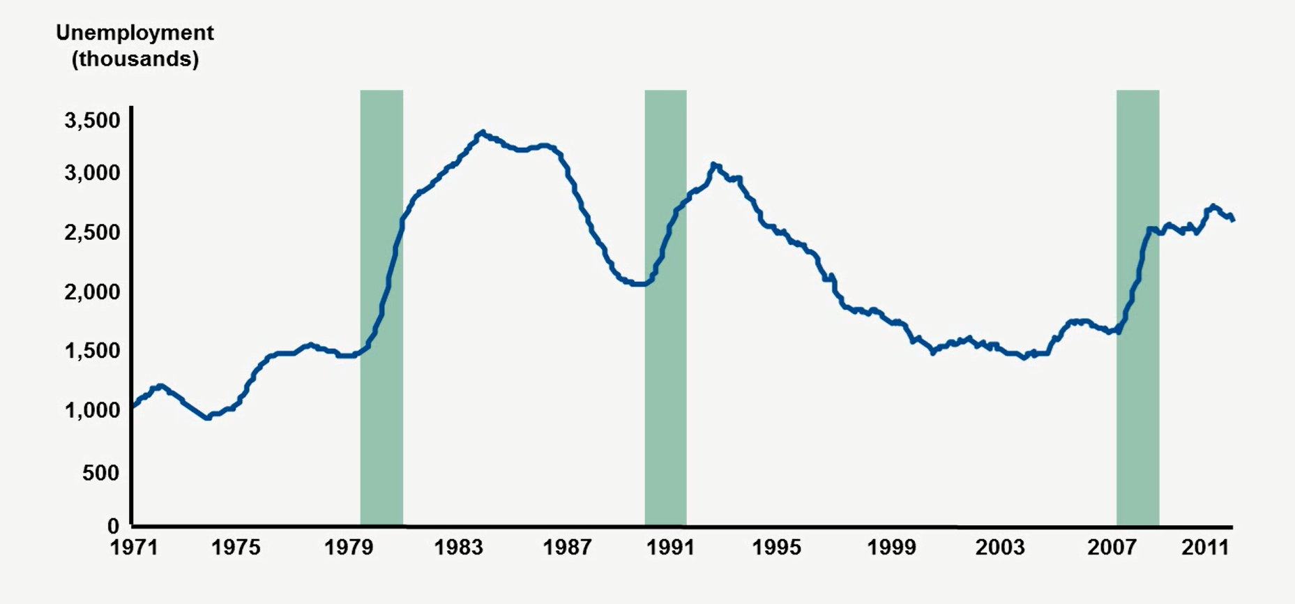
Unemployment 1971-2012
Significant Point From Data:

Slide 5
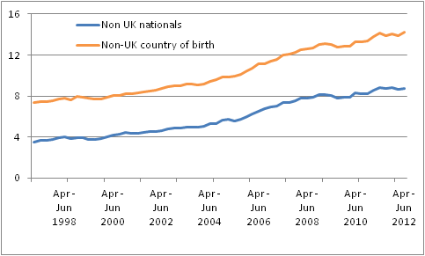
The Importance of Immigrants
Significant Point From Data:

Slide 6
Percentage of Part Time Workers
Significant Point From Data:

Slide 7
Occupations Among Employees By Sex
Significant Point From Data:

Slide 8
Employing People
One of the most important decisions a small business can take:
Full time employees
Part time employees
Temporary employees
Consultants and advisors

Slide 9
Full Time Employees Vs Part Time Employees
Benefits and Drawbacks Collective Memory Game.

Slide 10
Full Time Employees Benefits and Drawbacks
Benefits | Drawbacks
Higher output may be possible, as workers are able to commit to long hours. | Higher cost of employing people full time.
Employees are available all of the time to handle unexpected events. | Full time employees might not give the business flexibility in terms of an ability to meet an increase in demand.
Might be able to build better relationship with each other.
May build up better relationships with customers and provide good customer service.

Slide 11
Part Time Employees Benefits and Drawbacks
Benefits | Drawbacks
Flexibility of workers makes it easier to meet frequent changes in demand. | Part time staff may find it more difficult to access training.
Part time workers can be used when there are busy periods of trade e.g. hotels, supermarkets. | It may be more difficult to communicate with part time employees.
Allows employees to manage their home commitments e.g. children alongside a job | Part time employees may be less able to build close relationships with each other and customers.
Some part time staff job share, allowing a greater range of skills and talent to exist in the business. | Costs of employing a part time employee may not be much lower than a full time employee.

Slide 12
Female Part-Time Workers & Recession
http://news.bbc.co.uk/1/hi/business/7930975.stm
Female workers (part-time) hit hard by the recession.

Slide 13
Employment Quiz
A disadvantage of employing part-time employees is….
No need for induction training
Easier to communicate
Better able to handle peaks in workload
Less opportunity for training and promotion

Slide 14
Employment Quiz
An advantage of employing permanent employees is…
Only need them at times of peak demand
Employees take more training and career development opportunities
A variable not a fixed cost for business
They will have better skills than part-timers

Slide 15
Employment Quiz
Sole Traders don’t employ other people. True or False?
True
False

Slide 16
May 2009 Question 1F
Explain two possible advantages of Steve using part-time employees in his business (6 Marks)
Define part-time employees.
Explain two advantages of Steve’s business using part-time employees.

Slide 17
