Slide 1
Relationship Between Businesses & The Economic Environment
A2 Business Studies

Slide 2
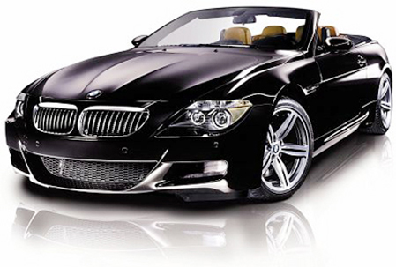
BMW Vs The Economy
BMW Battles Against Economic Forces : BBC News

Slide 3
Aims and Objectives
Aim:
To understand elements of the business cycle
Objectives:
Define Business Cycle
Describe the process of the business cycle.
Analyse the effects of the business cycle on firms.

Slide 4
Micro & Macro Factors
Micro
Economic factors operating within a business.
Macro
Economic factors operating in the whole economy.
Demand effects prices and output.
Supply effects prices and output.
Inflation
Interest Rates
Exchange Rates
Unemployment
Economic growth
Globalisation

Slide 5
Aggregate Demand and Aggregate Supply
Aggregate Demand:
The total demand in the economy made up of consumption, investment, government spending, exports and imports.
Aggregate Supply:
The total value of goods and services supplied in the economy.

Slide 6
Economic Growth
Economic Growth: the capacity of the economy to produce more goods and services over time.
GDP: most common measure of economic growth; total value of goods and services produced in the economy. Measured as a percentage.
Displayed on Business Cycle/Economic Cycle
http://www.bbc.co.uk/news/business-10730689

Slide 7
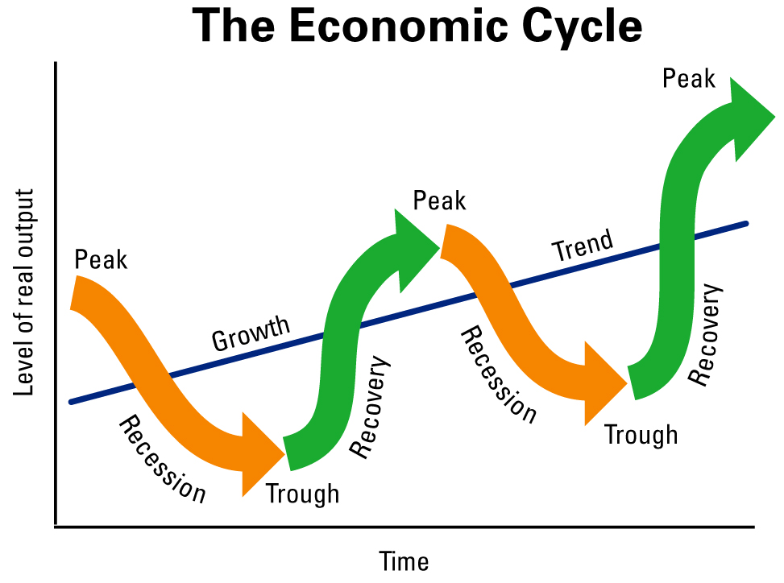

Slide 8
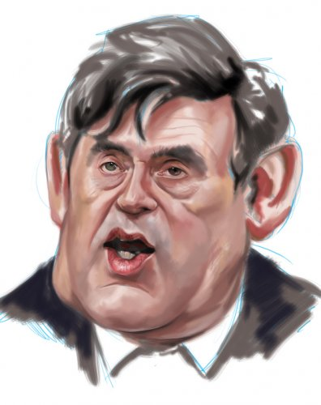
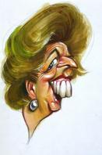
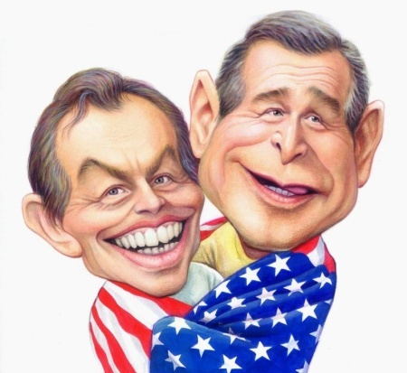
UK GDP
Economic Boom
Downturn
Recovery
Task: Two significant points of comparison.
Recession

Slide 9
Economic Cycle
Draw out the economic cycle on your whiteboards.
Write out the following statements and suggest with each letter where each statement occurs on the economic cycle.
E.g.
Trend Growth
GDP
Actual Growth
Time

Slide 10
A
Unemployment begins to rise
B
Unemployment begins to fall
C
Demand begins to rise
D
E
Demand begins to fall
Consumer confidence is high and firms benefit from high profits from high demand.
F
Firms are suffering from a contraction in demand and making redundancies.
G
Government intervenes to stimulate demand.
H
Household incomes are increasing.

Slide 11
I
Aggregate demand is exceeding aggregate supply, resulting in higher prices and inflationary pressure.
J
Consumer confidence is low, and instead of spending, consumers are saving, resulting in a contraction of AD.
K
Workers demand higher wage levels to keep up with inflation.
L
M
Interest rates are low in an attempt to boost consumer spending
The number of people claiming welfare benefits rises.

Slide 12
Output Gaps
Trend Growth
GDP
Actual Growth
Time

Slide 13
Business Cycle Stages
Boom
High Level of economic growth
Demand for products is high
Employment and wages are rising
Sales and profits are high
UK demand for imports is high
Products being made is high
Interest rates increasing
Investment high
GDP growth is higher than 2.5%

Slide 14
Business Cycle Stages
Downturn
Economic growth is slowing down.
Output is still rising
Output growth is falling

Slide 15
Business Cycle Stages
Recession
The economy has contracted and continued to contract.
People start to save rather than spend.
Investment falls.
Unemployment rises.
Government spending rises in an attempt to stimulate the economy.
Prices fall
Interest rates fall.
Negative GDP growth for 2 consecutive quarters.

Slide 16
Business Cycle Stages
Recovery
Recovery often needs a stimulus to start it off, such as government spending or cutting tax, known as expansionary fiscal policy.
Reduction in interest rates.

Slide 17
Article
Discussion
Effects of economic environment on firms.

