Slide 1
Developing and Implementing Workforce Plans
A2 Business Studies

Slide 2
Aims and Objectives
Aim:
Understand influences on workforce plans
Objectives:
Define workforce plans
Explain components of a workforce plan
Analyse the influences on workforce plans

Slide 3
Starter
Define ‘hard’ and ‘soft’ HRM.
Give two benefits of each
Give two drawbacks of each.
Which approach is better?

Slide 4
Workforce Planning
Workforce planning is about deciding how many and what types of workers are required.

Slide 5
Workforce Plans
Workforce Plans
Recruitment and Selection requirements
Training and development programmes
Retraining and redeployment programmes
Redundancy plans

Slide 6
Steps in Workforce Planning
Corporate Objectives set HR needs
Analyse existing workforce
Assess future needs (demand for labour)
Identify gaps in the workforce (gap analysis)

Slide 7
1) Corporate Objectives Sets HR Needs
Indicates likely demand for labour (e.g. Sales targets, units, locations, costs).
E.g. strategy of retrenchment will indicate significant reduction in demand for labour.

Slide 8
2) Analyse Existing Workforce
How many? Numbers, location, age, full/part-time, permanent/temps etc.
How do they perform? Productivity, retention etc.
How well does the existing workforce meet future needs?
A skills audit should help match existing skills with those needed.

Slide 9
3) Assess Future Needs (demand for labour)
Shaped by plans for markets, products & targets for efficiency and costs.
Consideration of technological improvements.
Considering changing economic, social and political environment.
E.g. recession should make it easier to recruit but will it also mean a reduction in consumer spending.
Must be based on reliable data – historical/future predictions

Slide 10
4) Identify Gaps in the Workforce (Gap Analysis)
Arise if the business does not have the staff with the right skills for future needs, or enough staff in total to meet demand.
Plan should identify the strategy for closing the gap – a combination of recruitment, promotion and training, including an estimate of the likely cost.

Slide 11
Internal Influences on Workforce Plans
Consider how the four internal influences will impact on workforce planning.

Slide 12
Internal Influences
Corporate Objectives:
Any change will impact workforce plan.
Production Objectives:
The required capacity, product quality and delivery are significant to the businesses’ demand for labour.
Marketing Objectives:
Development of new markets could lead to redeployment and recruitment of local sales force.
Financial Objectives:
Training costs, recruitment costs, depends on hard or soft HRM approach.

Slide 13
External Influences on Workforce Plans
Consider how each of the following will affect workforce planning:
Market demand
Labour market trends
Economic conditions
Social and political change
Local factors

Slide 14
External Influences
Market demand
Demand for the firms’ product determines production output which determines the demand for labour.
Labour market trends
The strength if the labour market determines how easy or difficult it is to recruit staff and the rates of pay

Slide 15
External Influences
Economic conditions
A weak economy may lower wage rates and make it easier to recruit, however market demand may fall.
Social and Political Change
Legislation such as minimum wage affects staff costs and planning.
Local Factors
Transport links, local school quality may affect planning.

Slide 16
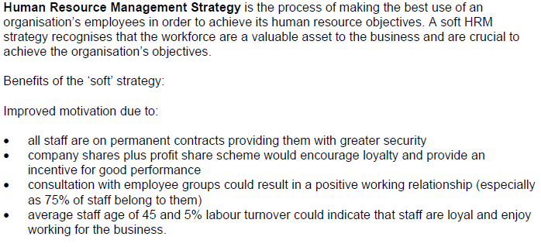
January 2010 Question 1 (10 Marks)

Slide 17
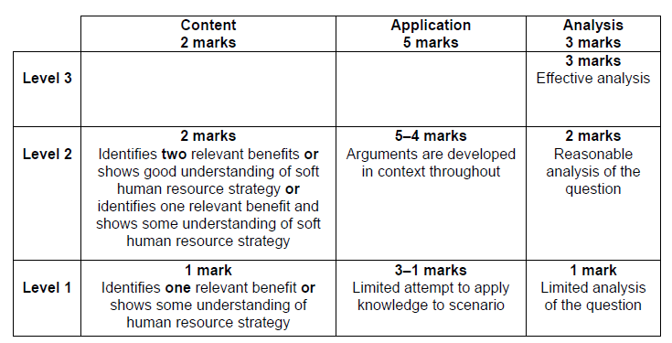
January 2010 Question 1 (10 Marks)

