Slide 1
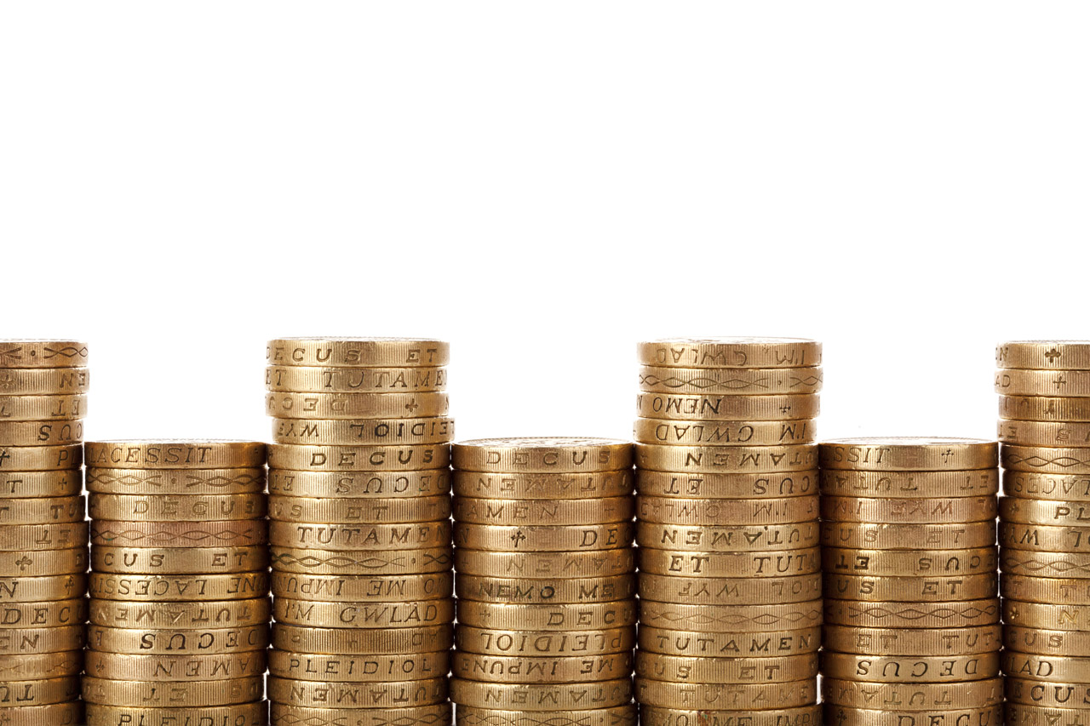
The Balance Sheet
A2 Business Studies

Slide 2
Aims & Objectives
Aim:
Understand methods of raising finance.
Objectives:
Define overdrafts and venture capitalist
Explain different internal and external methods of raising finance
Analyse internal and external methods of raising finance.

Slide 3
Starter
Define an income statement.
What are the formulas for working out gross profit margin and operating profit margins?
What tools might I use to judge whether a firm is more or less profitable between two years?
What does profit quality mean?

Slide 4
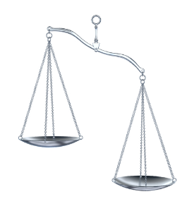
The Balance Sheet
This is a snapshot of the business’ assets (what it owns or is owed) and its liabilities (what it owes) on a particular day – usually the last day of a financial period.

Slide 5
Balance Sheet of Apple PLC as at 15th March 2011.
 | (£m) | (£m)
Fixed Assets
Premises |  | 3,001
Current Assets
Stock | 42
Debtors | 135
Cash | 75
Total Current Assets | 252
Less Current Liabilities
Creditors | (219)
Less Long Term Liabilities
Bank Loans |  | (1,734)
Net Assets | 1.300
Financed By
Capital | 450
Reserves and Retained Profit | 850
Capital Employed | 1,300

Slide 6
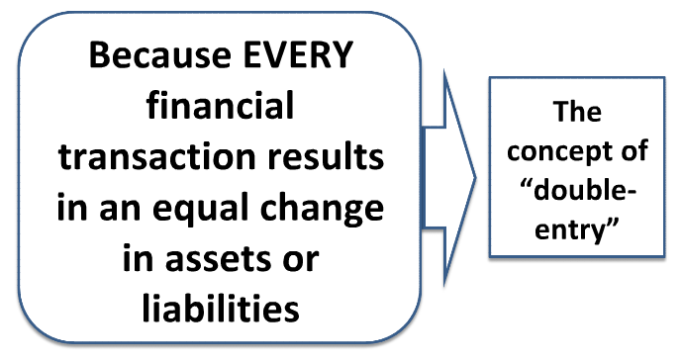
Why does the balance sheet balance?

Slide 7
Double Entry Examples
Transaction | Change in Assets | Change in Liabilities
Stocks bought from supplier on credit worth £5,000 | Stocks increase by £5,000 | Trade creditors increase by £5,000
Machinery bought for £100,000 in cash | Fixed assets increase by £100,000 Cash decrease by £100,000 | No Change
Cash Sales of £100,000 | Cash increase £10,000 | Profit increase by £10,000

Slide 8
Fixed Assets (Non-Current Assets)
Items of value owned by the business that are likely to be kept for more than one year.
Reflects the cost of capital expenditure.
Problem is that they depreciate (lose value over time).
Depreciation
Treated as a cost and deducted from the net asset value of the asset over time.

Slide 9
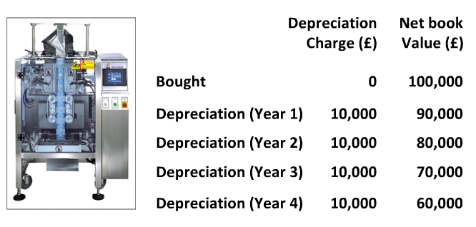
Depreciation Example

Slide 10
Intangible Assets
Purchased items without physical form such as goodwill or brand names.

Slide 11
Current Assets
Assets a business owns which are either cash, cash equivalents or are expected to be turned into cash during the next twelve months.

Slide 12
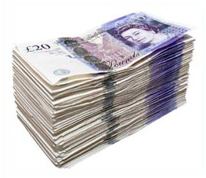
Liquidity of Assets
Means how easy it is to turn the asset into cash.

Slide 13
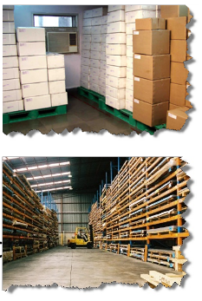
Inventories (Stocks)
The least liquid kind of current asset.
Valued at the cost they were bought (not selling price)
Value should reflect what could be recovered.

Slide 14
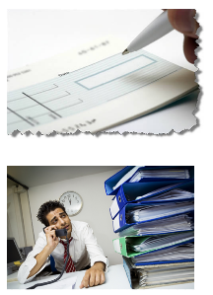
Debtors (Trade Receivables)
Amounts owed by customers buying on credit.
Late payment is a common and increasing problem.
Business should make provision for debtors not paying.

Slide 15
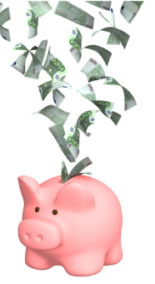
Cash and Cash Equivalents
The most liquid current asset!
Balance sheet shows cash held at period-end.
Can be manipulated through window-dressing.
Flood accounts with cash!

Slide 16
BIZQUIZ
Define fixed assets.
Define current assets.
Give two examples of each.
Explain what liquidity of assets means.
What does intangible assets mean?
Google’s brand name is worth $44bn, should this be included on its balance sheet?

Slide 17
Current Liabilities (Short Term Payables)
Financial obligations of the business payable within 12 months.

Slide 18
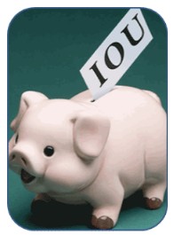
Creditors(Trade Payables)
Amounts owed to suppliers.
Important to take all supplier credit available.
Worth comparing level of debtors with creditors.

Slide 19
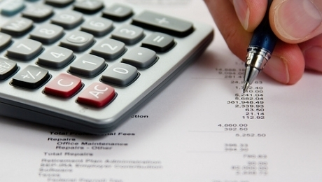
Short Term Borrowings
Balance on bank overdraft.
Proportion of loans which need to be paid back in 12 months.

Slide 20
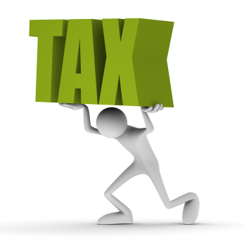
Current Tax Liabilities
Amounts owed to Inland Revenue
Corporation Tax
Income Tax
VAT

Slide 21
Non-Current Liabilities (Long Term Liabilities)
Debts that the business has more than one year to pay.
e.g. Bank loans

Slide 22
Equity
Share Capital
Cash raised by the business from the sale of new shares.
Retained Profit/Earnings
Net profits which have not been distributed to shareholders.

Slide 23
Balance Sheet of Apple PLC as at 15th March 2011.
 | (£m) | (£m)
Fixed Assets
Premises |  | 3,001
Current Assets
Stock | 42
Debtors | 135
Cash | 75
Total Current Assets | 252
Less Current Liabilities
Creditors | (219)
Less Long Term Liabilities
Bank Loans |  | (1,734)
Net Assets | 1.300
Financed By
Capital | 450
Reserves and Retained Profit | 850
Capital Employed | 1,300

Slide 24
Balance Sheet Worksheet
Peer Assessment
Feedback

